Slide 1

Thank You for Joining
College of Marin’s Benefits 101.
We will begin promptly at 10:00 AM.
Please do not share any private health information.
Direct personal program or plan questions to
Ron Owen rowen@marin.edu.
We will pause briefly at the end of each section for a limited number of questions. Enter general questions in the chat located in the bottom right corner.
A recording of this presentation and presentation deck will be posted online at hr.marin.edu/benefits.
Improve Your Viewing Experience!
Enlarge your screen by clicking “Alt” and “Enter”
Shrink your screen by clicking “Esc”

Slide 2


College of Marin
Employee Benefits Overview
Plan Year: Oct. 1, 2024- Sept. 30, 2025

Slide 3
Agenda
Common Insurance Terms
Employee Plan Options
Benefit Updates
Important reminders for each of the medical plan
  Kaiser Permanente plans
  Blue Shield PPO plans
Added Value Services
Wrap up with a General Q&A Session

Slide 4
Common Insurance Terms
Out-of-Pocket Expense – any payment made by the member, whether it be a co-pay, the deductible, or coinsurance
Copayment/Co-Pay – a flat dollar amount paid for an office visit, service, or prescription
Deductible – an amount a member must pay before plan begins paying for services
  Deductibles are waived for industry-standard preventive care on all plans.
Percent of Coverage/Co-insurance – percent an individual pays once deductible is met
  Example: If a member is on a 90% plan, the member will pay 10% of costs, or the associated copay, once deductible has been met
Out-of-Pocket Maximum – the maximum amount a member will pay for services within the calendar year. Payments include copays, deductibles, and coinsurance for in-network services or emergency services.
  Once the OOPM is met, the individual will have 100% coverage with no out-of-pocket payments for the remainder of that calendar year. Out-of-network payments by the member do not apply to OOPM.
4th Quarter Deductible Carry Over – pertains to any amount paid towards the deductible during the fourth quarter of a calendar year (between October 1 and December 31), amount is then credited to the following year’s deductible.
  Due to IRS rules, there is no 4th quarter deductible carry over on SISC high deductible health savings account-compatible health plans!
Members should reference their evidence of coverage for detailed information
on these services.

Slide 5

Kaiser Permanente
Health Maintenance Organization (HMO)
SISC Kaiser Permanente Medical Plan Options
10/01/2024 - 09/30/2025
Benefits | TRADITIONAL HMO PLAN | DEDUCTIBLE HMO PLAN | $1,700 HSA
Calendar Year Deductibles & Maximums
Calendar Year Deductible | None | $1,000 / $2,000 | $1,700 / $3,400
Single / Family
Annual Out-of-Pocket Maximum | $1,500 / $3,000 | $3,000 / $6,000 | $3,400 / $6,800
Single / Family
Professional Services
Physician Office Visit | $20 per visit | $20 per visit | 10% per visit after ded
Preventive Care | No Charge | No Charge | No Charge
Lab and X-Ray | No Charge | $10 per encounter | 10% per encounter after ded
Chiropractic | $10 per visit (30 visits / year) | $10 per visit (30 visits / year) | Not Covered
Acupuncture |  |  | 10% per visit after ded, referal required
Infertility Services
Office Visits | $20 per visit | $20 per visit | 10% per visit after ded
Most outpatient surgery & procedures | $20 per procedure | 20% per procedure after ded | 10% per procedure after ded
Covered Reproductive Technology | Artificial Insemination Only | Artificial Insemination Only | Artificial Insemination Only
Hospitalization
Inpatient Hospitalization | No Charge | 20% per admit after ded | 10% per admit after ded
Outpatient Surgery | $20 per procedure | 20% per procedure after ded | 10% per visit after ded
Other Benefits
Ambulance | $50 per trip | $150 per trip | 10% per trip after ded
Emergency Room | $100 per visit (waived if admitted) | 20% per visit after ded | 10% per visit after ded
Mental Health
Inpatient | No Charge | 20% per admit after ded | 10% per admit after ded
Outpatient | $20 (individual); $10 (group) | 20% per visit after ded | 10% per visit after ded
Substance Abuse
Inpatient | No Charge | 20% per admit after ded | 10% per admit after ded
Outpatient | $20 (individual); $5 (group) | 20% per visit after ded | 10% per visit after ded
Prescription Drugs | Generic / Brand | Generic / Brand
Retail | $10 / $20 (100 day supply) | $10 / $30 (30 day supply) | $10 / $30 (30 day supply) after ded
Mail Order | $10 / $20 (100 day supply) | $20 / $60 (100 day supply) | $20 / $60 (100 day supply) after ded

Slide 6
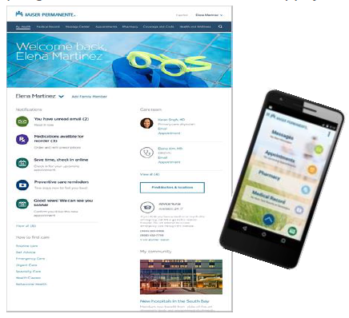
Kaiser Permanente
Online and Mobile App
At kp.org or with the Kaiser Permanente app, members can stay on top of their care 24/7:^{1,2}
  Schedule and cancel routine appointments
  Fill most prescriptions
  Choose your doctor and change anytime
  View most lab test results
  Email your Kaiser Permanente doctor’s office with non urgent questions
  Manage your coverage and estimate costs³
  View and pay bills
  Manage a family member’s health care⁴
¹Available when you get care at Kaiser Permanente facilities.
²To use the Kaiser Permanente app, you must be a Kaiser Permanente member registered on kp.org.
³These tools are not available on the app.
⁴Online features change when children reach age 12. Teens are entitled to additional privacy protection under state laws. When your child turns 12 years old, you will still be able to manage care for your teen, with modified access to certain features.

Slide 7

Kaiser Permanente
Care Options
Members have access to in-person and virtual care:
  Visit your doctor at your local facility
  Meet face-to-face with a video visit*
  Save yourself a trip to the doctor’s office with a telephone appointment*
  Email your Kaiser Permanente doctor’s office with non urgent questions at kp.org or with the KP App
  Schedule appointments and get 24/7 medical advice by calling 1-866-454-8855
  Emergency and urgent care coverage worldwide and 24/7 support with the Away from Home Travel Line at 1-951-268-3900**
*When appropriate and available.
**This number can be dialed inside and outside the United States. Before the phone number, dial “001” for landlines and “+1” for mobile lines if you’re outside the country. Long-distance charges may apply, and Kaiser Permanente can’t accept collect calls. The phone line is closed on major holidays (New Year’s Day, Easter, Memorial Day, July Fourth, Labor Day, Thanksgiving, and Christmas). It closes early the day before a holiday at 10 p.m. Pacific time (PT), and reopens the day after a holiday at 4 a.m. PT.

Slide 8


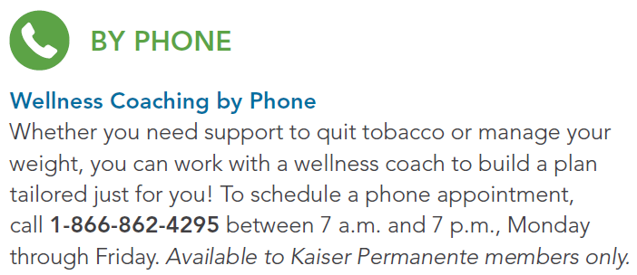
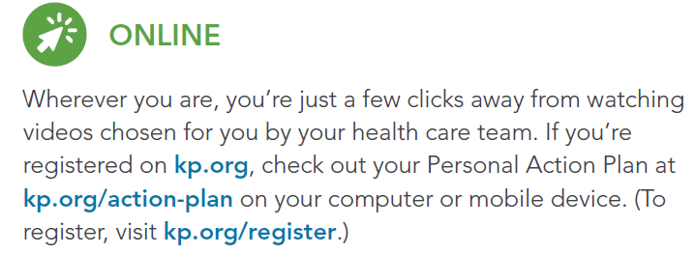
Kaiser Permanente –
Health and Wellness - Available at little or no cost

Slide 9
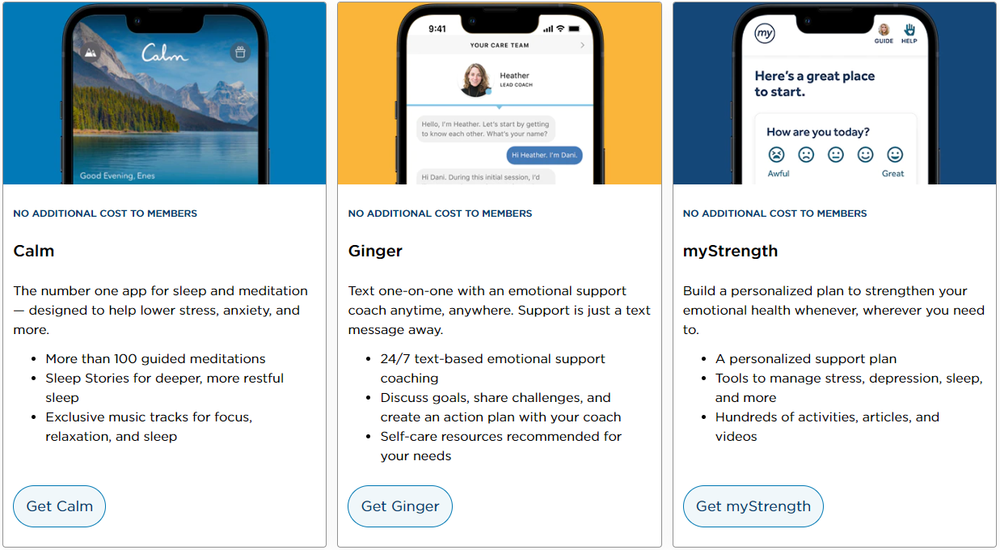
Kaiser Permanente –
Self-care apps for your everyday life- Available at No Cost
Visit kp.org/selfcareapps to learn more.

Slide 10

Blue Shield of California
Preferred Provider Organization (PPO)
SISC Blue Shield Medical Plan Options Effective 10/01/2024 - 09/30/2025
Benefits Plans | 100% Plan A | 80% Plan K | 2-Tier HSA $5,000 | HSA $1,700 Individual | HSA $1,700 Family
Calendar Year Deductibles and Maximums | In-Network | In-Network | In-Network | In-Network | In-Network
Calendar Year Deductible | None | $1,000 / $2,000 | $5,000 / $10,000 | $1,700 | $3,400
Single / Family
Annual Out-of-Pocket Maximum | $1,000 / $3,000 | $3,000 / $6,000 | $6,350 / $12,700 | $3,400 | $3,400 / $6,800
Single / Family
Professional Services
Physician Office Visit | $20 per visit | $30 per visit | 30% after ded | 10% per visit after ded
Preventive Care | No Charge | No Charge | No Charge | No Charge
Lab and X-Ray | No Charge | 20% after ded | 30% after ded | 10% after ded
Chiropractic (up to 20 visits/ calendar year) | No Charge | 20% after ded | 30% after ded | 10% after ded
Acupuncture (up to 12 visits/ calendar year) | No Charge | 20% after ded | 30% after ded | 10% per visit after ded
Infertility Services | Not Covered | Not Covered | Not Covered | 10% per visit after ded
Hospitalization
Inpatient Hospitalization | No Charge | 20% after ded | 30% after ded | 10% after ded
Outpatient Surgery | No Charge | 20% after ded | 30% after ded | 10% after ded
Other Benefits
Ambulance | $100 copay | $100 copay + 20% after ded | $100 copay +30% after ded | $100 copay + 10% after ded
Emergency Room (copay waived if admitted) | $100 per visit | $100 per visit + 20% after ded | $100 per visit + 30% after ded | $100 per visit + 10% after ded
Mental Health
Inpatient | No Charge | 20% after ded | 30% after ded | 10% after ded
Outpatient | $20 per visit | $30 per visit | 30% after ded | 10% after ded
Substance Abuse
Inpatient | No Charge | 20% after ded | 30% after ded | 10% after ded
Outpatient | $20 per visit | 20% after ded | 30% after ded | 10% after ded
Prescription Drugs
Rx Specific Out-of-Pocket Maximum | $1,500 / $2,500 | $2,500 / $3,500 | Medical Deductible + Out-of-Pocket Maximum | Medical Deductible + Out-of-Pocket Maximum
Retail | $5 / $20 / $20 (30 day supply) | $9 / $35 / $35 (30 day supply) | $9 / $35 / $35 (30 day supply) after ded | $9 / $35 / $35 (30 day supply) after ded
Mail Order | $0 / $50 / $20 (90/90/30 day supply) | $0 / $90 / $35 (90/90/30 day supply) | $0 / $90 / $35 (90/90/30 day supply) after ded | $0 / $90 /$35 (90/90/30 day supply) after ded

Slide 11
Important Reminders
Blue Shield Members
The first 3 visits with your primary care physician will be at a $0 copay.
Some services provided by non-contracting or out-of-network providers are not covered and do not accumulate towards Out-of-Pocket Maximums, including but not limited to:
    X-Ray/Imaging
    Laboratory
    Durable Medical Equipment (DME)
    Physical Medicine Services
    (Chiropractic, Physical or Occupational Therapy)
    Preventive Services
Physical Medicine Services (Chiropractic, Physical or Occupational Therapy) require Prior Authorization after the first five visits.
Call Blue Shield Member Services at 855-599-2657 prior to scheduling any surgeries.
  All inpatient surgeries require prior authorization.
  Some inpatient surgeries require the use of specific facilities such as Centers of Medical Excellence (transplants) or Blue Distinction+ (bariatric) hospitals.
Blue Shield members receive $0 generics (excludes certain pain and cough medications) from Costco once deductibles (if any) are satisfied.

Slide 12
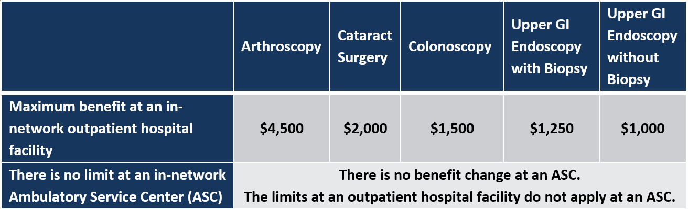
Important Reminders
Blue Shield Members
Blue Shield members are subject to reference pricing for five common outpatient procedures that can be performed safely at an Ambulatory Surgery Center (ASC) at costs significantly lower than at a hospital. Members with questions should contact the customer service number on their ID cards.

Slide 13
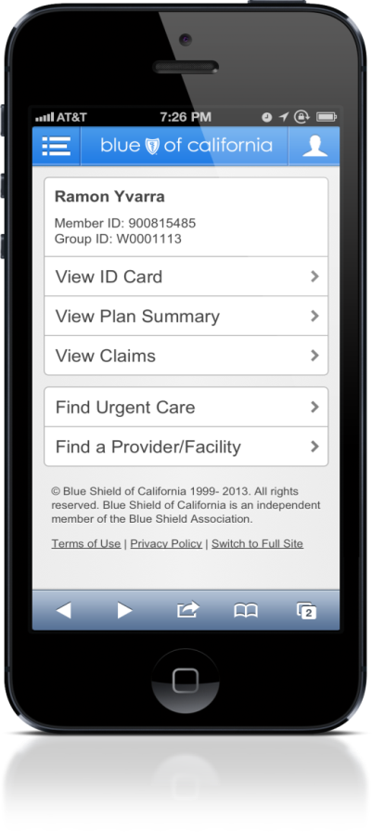
Blue Shield of California
Preferred Provider Organization (PPO)
Online and Mobile App
At blueshieldca.com or with the Blue Shield app, members can stay on top of their care 24/7:
  Find a doctor or urgent care center near you
  View or print your Blue Shield member ID card
  Check your deductible and copayment/coinsurance year-to-date totals
  View your claims
  Review your benefits information
  See your wellness benefits

Slide 14
Navitus Health Solutions
Outpatient Prescription Drug Coverage for Anthem members
Navitus is SISC’s pharmacy benefit manager.
SISC/Navitus Network of Pharmacies
  The network includes most independent pharmacies and all major chain pharmacies except Walgreens
Navitus Formulary
  When determining how drugs are covered, Navitus pharmacists and physicians evaluate therapeutic value, effectiveness and side effects to determine medications included on the formulary. From time to time, Navitus adds new coverage limitations or removes certain medications from coverage. When they do this, Navitus pharmacists and physicians always make sure that high quality, safe and effective alternatives are available.
  Some covered medications require step-therapy or prior authorization and some therapeutic classes of medication use preferred medications. Members should register with Navitus.com to view the most up-to-date formulary.

Slide 15

Navitus Health Solutions
Outpatient Prescription Drugs - continued
Available 24/7, Navi-gate allows Anthem members to manage their personal pharmacy benefit information.
At navitus.com/members, you can:
  Search pharmacies
    Note: SISC Rx plans do not contract with Walgreens
  Search prescription drugs
  View copay information
  View medication history
  View drug interactions
  Access forms
  And more!
Members can reach Navitus Customer Care 24/7 by calling 1-866-333-2757. Members can also ask to speak directly with a pharmacist for questions and concerns.

Slide 16

$0 Generics at Costco Pharmacy
All SISC Anthem PPO members receive $0 generic* drugs at all Costco retail and mail order pharmacies. You do not need to be a Costco member to access their retail or mail order pharmacies.
How to fill a prescription at a retail Costco pharmacy:
Bring your generic prescription to a Costco Pharmacy for $0 generic* 30 or 90-day prescriptions and supplies.
How to fill a mail order prescription through Costco:
Go online to Costco.com/home-delivery to get started; or:
Submit your prescription with a Costco Mail Order form to:
      Costco Mail Order Pharmacy
      215 Deininger Cir,
      Corona, CA 92880-9911.
If you have any questions or need assistance, call Costco Mail Order Pharmacy at 1-800-607-6861.
*Excludes some narcotic pain and cough medications

Slide 17

Added Value Programs
Counseling Services
Available to ALL Employees at No Cost
Employee Assistance Program (EAP)
All employees and everyone in their household have access to up to 6 free and confidential* counseling sessions per issue through Anthem EAP.
The EAP program features 24/7 telephone access to clinicians and can assist participants in:
  Finding work-life balance
  Parenting a child with special needs
  Dealing with addiction and recovery
  Setting retirement goals
  Getting mental health resources and information
  Just about anything else life throws at you
1-800-999-7222
www.anthemeap.com
Company Code: SISC
Administered by Anthem for SISC
Notes:
An employee assistance program – or also known as EAP – provides quick and easy access to confidential resources to help you meet the challenges you face daily, such as marital issues, depression, locating child care, stress, work-related issues, etc. Resources are available via the EAP website or by speaking with an EAP consultant via the toll-free EAP telephone number. You can find out the number for your EAP from your member materials or from your Human Resources Department.
Your EAP is an information, support, and referral service to help you maximize your well-being and achieve your best.

Slide 18

Added Value Programs
Kaiser Permanente and Blue Shield Members
Expert Medical Opinions Available at No Cost
Teladoc Medical Experts
Blue Shield PPO and Kaiser Permanente members can
get answers to healthcare questions and medical opinions from world-leading experts in their fields of specialty through Advance Medical. Members can speak directly with a specialist once their case is established.
Advance Medical can help members when they:
  Are dealing with complex medical conditions
  Are considering surgery or a major procedure
  Have questions about managing a health condition
  Want a second opinion on a documented diagnosis or treatment plan
Visit Teladoc.com/sisc or call 1-800-835-2362 to learn more.

Slide 19


Added Value Programs
Blue Shield Members
24/7 Phone and Video Physician Consultations
MDLive
Blue Shield PPO members can consult with MDLive doctors and pediatricians over the phone, by video visit, or by using the mobile app, for a $10 copay* via MDLive. All visits are confidential.
Physicians can advise on a variety of medical conditions including:
General Contitions
  Cough
  Cold
  Fever
  Flu
  Infection
  Children’s health issues
  And more
  Behavioral Health
    Depression
    Bipolar disorders
    Stress
    Grief and loss
    And more
MDLive physicians can diagnose, recommend a treatment, and prescribe medication when appropriate.
Visit MDLive.com/SISC or call 1-800-657-6169 for more information.
*Per IRS guidelines, this benefit is subject to deductible for HSA members.

Slide 20

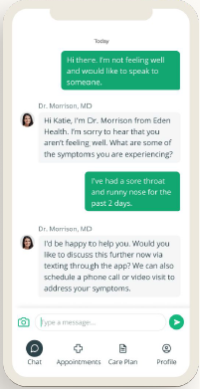

Added Value Programs
Blue Shield Members
Primary Care in the palm of your hand at No Cost
Eden Health
Blue Shield PPO members have 24/7 access to a Care Team who works together to offer you primary care, mental health support, and answers to follow-up care questions through one app.
Your primary care team can provide support in numerous areas including:
  Diagnoses and Treatments
  Prescription Refills
  Scheduled video visits or live chat with a primary care physician
  Answer follow-up care questions
  Specialists Referrals to providers in your network
  Mental Health Support
Scan the QR code to download the Eden Health app,
and register for your free Eden Health membership.
This Program is not available to HSA, HMO, or Kaiser members.

Slide 21

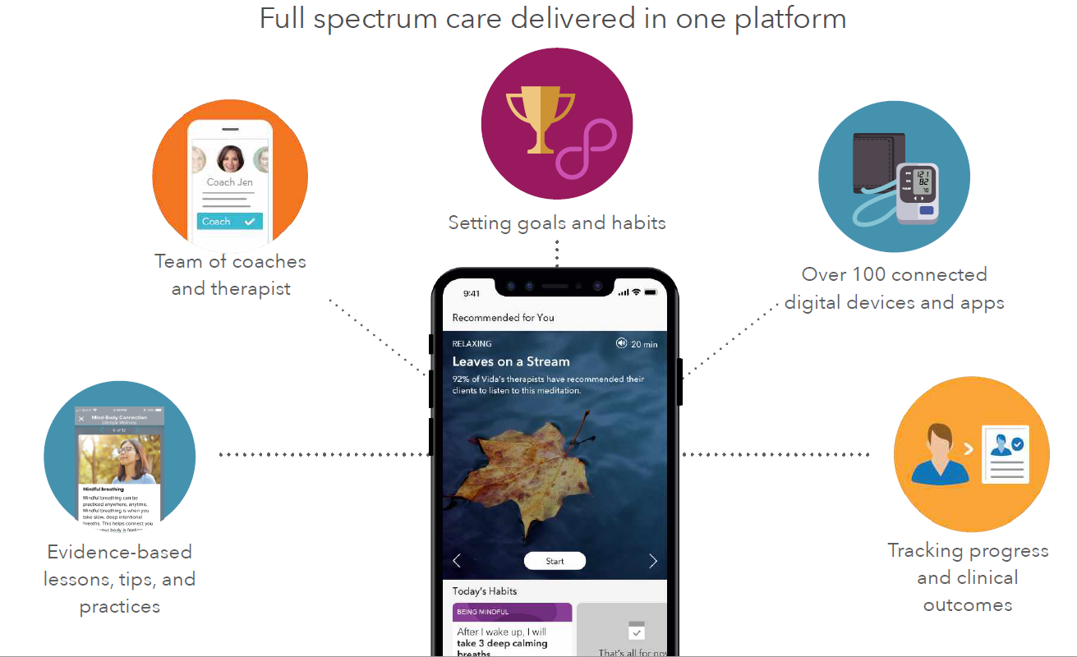
Added Value Programs
Blue Shield Members
One-on-One Digital Health Coaching Available at No Cost*
Vida
Blue Shield PPO members have access to a virtual care platform that treats a full range of lifestyle, chronic, and behavioral health conditions through Vida Health. Users receive:
  1:1 health coaching and therapy available through a virtual platform
  Digital interventions and programs
  Progress tracked through in-app trackers and connected devices
  Tools and resources such as videos and lessons
Visit Vida.com/SISC or call 1-855-442-5885 to learn more.
*Per IRS guidelines, these chronic condition management and therapy programs are subject to the deductible for HSA members. This program will no longer be available to HSA members effective January 1, 2024.

Slide 22


Added Value Programs
Blue Shield Members
Pregnancy and Postpartum Support at No Cost
Maven
Blue Shield PPO members have free access to maternity and postpartum care through Maven. Maven offers 24/7 virtual access to one-on-one maternity and postpartum support. Participants are matched with a Care Advocate who connects them to trustworthy maternity and postpartum content delivered by doctors, specialists, coaches, and other maternity providers. Care is specific to issues new parents may be experiencing.
Free 6-Month Diaper Subscription if Member:
  Enrolls in Maven during their first or second trimester
  Has an intro call with a Care Advocate
  Has two appointments with Maven providers during pregnancy
  Completes exit survey when their baby is born
Visit Mavenclinic.com/join/SISC to learn more.

Slide 23

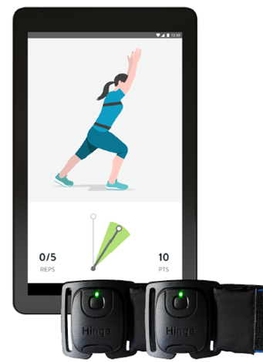
Added Value Programs
Blue Shield Members
Digital Programs for Chronic Pain Available at No Cost*
Hinge Health
Blue Shield PPO members have access to a digital physical therapy program through Hinge Health. This program provides personalized, interactive therapy using the latest technology for those suffering from chronic pain.
Eligible members receive wearable sensors and a monitoring device to guide them through virtual therapy sessions from home. Hinge Health also provides unlimited access to a personal health coach, links to educational articles, and information regarding available treatment options.
Members can access support for the following:
  Hip pain
  Knee pain
  Neck pain
  Spine pain
  Shoulder pain
Visit HingeHealth.com/SISC or call 1-855-902-2777 to learn more.
*Per IRS guidelines, these chronic condition management and therapy programs are subject to the deductible for HSA members. This program will no longer be available to HSA members effective January 1, 2024.

Slide 24



Added Value Programs
Hip, Knee, and Spine Surgical Options Available at No Cost*
  Carrum Health
  Blue Shield PPO members can access Carrum Health’s surgery benefit that provides exclusive access to “Centers of Excellence” with Exceptional care from the country’s top surgeons at
    Scripps Hospital in La Jolla, CA, or
    Stanford Hospital-Valley Care in Pleasanton, CA.
  Patients receive:
    Personalized “Concierge” support
    Access to top-quality surgeons at Scripps
    Co-insurance and deductibles are waived
    Travel expenses covered for the patient and one companion
  Eligible procedures include:
    Hip Replacement
    Knee Replacement
    Cervical Spinal Fusion
    Lumbar Spinal Fusion
  This benefit is exclusive to Scripps Hospital and must be accessed through Carrum Health. Call 1-888-855-7806 to learn more.
*Per IRS guidelines, this benefit is subject to deductible for HSA members.

Slide 25
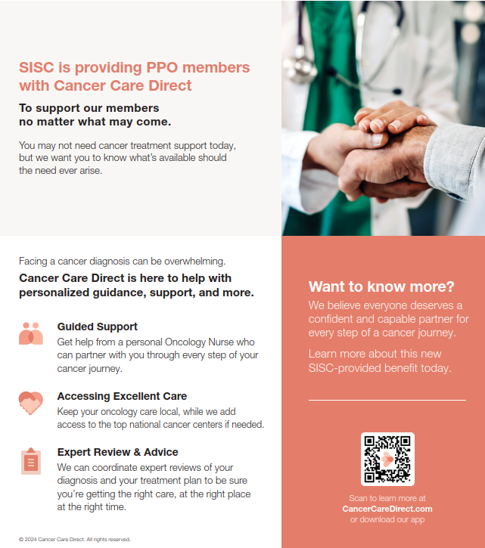

Added Value Programs
Cancer Care Direct

Slide 26
Added Value Programs
Kaiser Permanente and Blue Shield Members
Discounted Gym Memberships
Blue Shield
Members have access to a $25 gym membership (+one-time $25 enrollment fee) at a broad network of participating facilities through Tivity Health’s Fitness Your Way program.
Visit FitnessYourWay.TivityHealth.com/BSC to locate facilities and enroll. Members may also call Tivity Health directly at 1-833-283-8387 for more information.
Kaiser Permanente
Members have access to a $28 gym membership (+one-time $28 enrollment fee) at a broad network of participating facilities through American Specialty Health’s Active & Fit Direct program.
Visit kp.org/choosehealthy to locate facilities and enroll. Members may also call American Specialty Health directly at 1-844-646-2746 for more information.

Slide 27
Added Value Programs
Flu Vaccines
Available to all SISC Members at No Cost
Blue Shield
Free flu shots are available at any participating pharmacy, including Costco (1-800-774-2678/ Costco.com) and excluding Walgreens.
Kaiser Permanente
Free flu shots are available at many Kaiser Permanente locations. Visit kp.org/flu or call
1-800-573-5811 for more information on flu clinic hours and locations.

Slide 28
Questions?

