Slide 1
College of Marin Recruitment Process Training for Hiring Managers
by Employment Services Team, Human Resources Department
Notes:
Welcome! This presentation will review the hiring steps for the various types of positions and faculty pools we have at College of Marin. Please keep this guide for future reference. If, at the end of the presentation, you have any questions or need clarification in any area, please feel free to reach out to any of the Employment Services Team members; our contact information is included on the last slide.

Slide 2
EMPLOYMENT SERVICES OVERVIEW
As an essential part of the human resources function, Employment Services provides comprehensive services, support, and general oversight for all aspects of the recruitment and hiring process.
Notes:
As an essential part of the human resources function, Employment Services provides comprehensive services, support, and general oversight for all aspects of the recruitment and hiring process.

Slide 3
EMPLOYMENT SERVICES OVERVIEW
Work with the Hiring Manager to develop the job or pool posting, including minimum requirements and desirable characteristics.
Respond to questions and concerns expressed by applicants, screening committee members or other individuals involved in the hiring process.
Match the requirements of a position vacancy with State minimum qualification requirements, if any, to be included in the job posting.
Advertise job/pool with various web sites and publications to draw a diverse pool of applicants.
Screen for minimum requirements for all positions/pools.
Request participants from constituency group leaders to serve on screening committees.
Compile all materials from applicants for committee members.
Coordinate with the Academic Senate President and Equivalency Committee to process applications for equivalency (faculty positions/pools).
Approve screening criteria, interview questions and guideline answers developed by the Screening Committee.
Review list of candidates selected to interview and list of recommended finalists.
Coordinate with Hiring Manager to conduct reference checks. Review all committee materials upon return to ensure completeness and that appropriate procedures were followed.
Screen for adverse impact throughout the recruitment process.
Act in an advisory capacity to all committees to ensure fairness and adherence to all state and federal laws and local policies and procedures.
Arrange reasonable accommodation for applicants.
Notes:
Employment Services will work closely with the Hiring Manager to develop the posting, advertise the opening, and to secure a screening committee.
Once the committee convenes to develop screening tools and to screen applications, Employment Services will review the committee’s progress for adverse impact and to ensure fairness and adherence to state and federal laws and local policies and procedures.
Throughout the recruitment, Employment Services will coordinate with the Hiring Manager to complete each step of the process within the anticipated timeline.
Please take a few moments to review this slide.

Slide 4
HIRING MANAGER’S ROLE
Notes:
Now that we’ve covered Employment Services’ role and responsibilities, let’s review the Hiring Manager’s role.

Slide 5
HIRING MANAGER’S ROLE
Serve as chairperson for the screening committee
Schedule and host screening committee meetings
Inform committee members of the job-related qualities to look for in candidates
Assist with developing criteria/interview guide
Schedule and confirm all interviews with candidates
Schedule and arrange room(s) for interviews
Notify HR of finalists or selected candidates
Conduct second interviews (classified positions only)
Check references of finalist(s)
Make verbal job offer (classified positions only)
Ensure all documentation is completed, signed, and returned to HR
Ensure the hiring procedures are followed and communicate with Human Resources if there are any questions or issues.
Notes:
Under the guidance of Employment Services – or Human Resources – the Hiring Manager will serve as the point-person for the screening committee throughout the recruitment.
The Hiring Manager will be responsible for scheduling and hosting all of the meetings and interviews, while keeping HR informed of the committee’s progress along the way.
Please take a few moments to review this summary of the Hiring Manager’s roles before we continue.

Slide 6
RECRUITMENT TRIGGERS
New Position
Vacancy (Retirement, Resignation, Termination)
District Reorganization
Faculty Temp Pool Exhausted
Notes:
It’s time to recruit! For a formal recruitment to take place, one of these four triggers must occur. And for the first three, California Education Code requires the employer to recruit from within and outside of the District. Temp Pool recruitments may be held at the discretion of the District and as deemed necessary to maintain adequate staffing.

Slide 7
GETTING STARTED: Hiring Manager (HM)
Funding
Job Description
Personnel Requisition
Temp Pool Requests
Expedited Hire Process & Form
Notes:
Once the vacancy type is defined, the recruitment process may begin, starting, in most cases, with the funding confirmation and the job description.
Pause

Slide 8
JOB DESCRIPTION
Prior to initiating the job description review process, HM should consult appropriate Assistant Superintendent/Vice President to confirm funding and for authorization to conduct a recruitment.
New Positions & Existing Positions Requiring Significant Changes
HM submits draft of new or revised description to Human Resources (HR) for Classification & Compensation review
For represented positions, HR submits new/revised description to respective union for bargaining
HR submits description to Board of Trustees for approval
For Existing Position Requiring Minor or No Changes
HM submits draft of revised description to HR for review and approval
If no changes, HM confirms with HR to use current job description
Notes:
When an opening occurs, the job description should be reviewed, so the Hiring Manager should request a copy of the current description from HR. Only Management, Supervisory, and Classified positions have job descriptions; for faculty positions and temp pools, the most recent posting is used for job description purposes.
Following the Executive Director of Human Resources’ review for classification and compensation, positions represented by CSEA must be vetted at the union’s state and local level prior to being submitted to the Board of Trustees for approval. And, SEIU positions must be vetted at the union’s local level prior to being submitted to the Board.
New positions are not posted without approval by the Board.
4. One note: to allow HR to make necessary adjustments for submitting job descriptions for approval, we request that all drafts be submitted as Word documents versus PDFs or other formats.

Slide 9
PERSONNEL REQUISITION & TEMP POOL REQUESTS
PERSONNEL REQUISITION
Required for all positions, except temp pools
HM should consult appropriate Assistant Superintendent/Vice President for authorization prior to contacting HR for a recruitment
HM initiates and routes requisition to next party in queue
Remember to include FOAP(s)!
Fund-Organization-Account-Program (if you need assistance locating a FOAP, please contact Fiscal Services)
TEMP POOL REQUESTS
No requisition form required to request a temp pool recruitment
HM should consult Assistant Superintendent/VP of Student Learning & Success for authorization prior to contacting HR for a recruitment
HM emails HR to request a recruitment
Notes:
1. Once a job description is approved by all parties, the Hiring Manager completes and routes the Personnel Requisition form. Incomplete requisitions will be returned to the Hiring Manager, which could delay the recruitment process, so be sure to include all of the requested information, especially the FOAP, which defines the budget, or budgets, from which the position’s compensation will be paid. Some positions split the compensation between two areas.
To avoid delays in the process, be sure to route the requisition to the next party in the routing queue.
3. Temp pool recruitments do not require a personnel requisition.

Slide 10
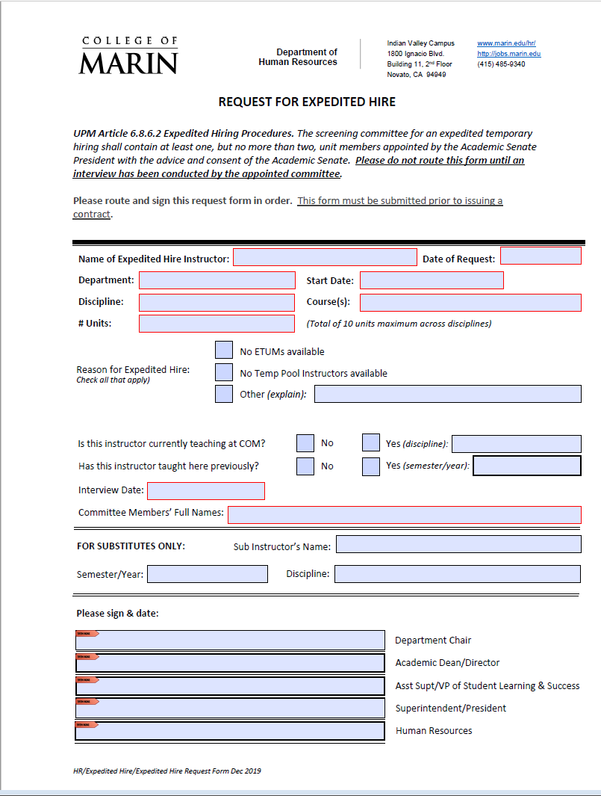
EXPEDITED HIRE PROCESS
Contact HR for more information should the need for an expedited faculty hire arise.
For unexpected situations where no Eligible Temporary Unit Member (ETUM) or temp pool instructors are available and a competitive recruitment cannot be completed within a reasonable timeframe
HM or Department Chair (DC) may initiate the expedited hiring process (shown)
Sample Situations: illness/injury, death, unexpected resignation/retirement/termination, or reassignment.
Notes:
In some emergency-type situations, it may be necessary to hire a faculty member on an expedited basis. Please contact HR for more information, should this situation arise.
PAUSE

Slide 11
READY TO RECRUIT: Human Resources (HR)
Posting Developed
Recruitment Timeline Developed
Position/Pool Posted
Committee Formed
NeoEd Account Set-up
Notes:
Once the completed requisition is received in HR, the recruitment process may begin.
Pause

Slide 12
POSTING DEVELOPED RECRUITMENT TIMELINE DEVELOPED & POSITION/POOL POSTED
POSTING DEVELOPED BY HR
HM reviews and approves posting
RECRUITMENT TIMELINE DEVELOPED BY HR
Provides the anticipated duration of the recruitment, step by step.
POSITION/POOL POSTED
COM’s job site (NeoEd*): http://jobs.marin.edu
External Web Sites (see Advertising Resources on next slide)
ListServs, Other Professional Sources (membership organizations, colleagues, etc.) HM & Department Chair/Coordinator announce posting to all staff & faculty in department (ETUMs, Temp Pool Instructors, Classified Staff, and Hourly Employees)
*Formerly known as NeoGov
Notes:
1. Using the approved job description, HR drafts and sends the posting to the Hiring Manager for approval
2. All openings are posted on College of Marin’s job site, which is powered by NeoEd, also known as NeoGov or GovernmentJobs.com. Applicants access our site using the jobs.marin.edu URL.
3. HR will also post the opening externally, and for harder-to-fill positions, may consult the Hiring Manager for discipline or job-specific sources.
4. It is critical that all ETUMs and Pool Instructors are made aware of any FT faculty openings, since these are promotional opportunities for them. Similarly, any hourly or department-specific employees should be notified of any Classified openings that would offer promotional opportunity.

Slide 13
EXTERNAL WEBSITES - Advertising Resources
ACCCA.org
BlacksinHigherEd.com
CalJobs.ca.gov
CCCRegistry.org
Chronicle.com
Craig’s List
Diverse Issues in Higher Education
EdJoin.org
HigherEdJobs.com
HispanicsinHigherEd.com
Indeed
This list varies and may be revised as necessary. If you have a job-specific website or resource where you would like to advertise the position or pool, the hiring department may be responsible for incurring the cost.
Notes:
The College advertises openings regularly at the sites listed here. If your there are industry or job-specific web sites, publications, or other locations where you would like to advertise the position, HR will work with you to place those ads. However, depending on the source, the hiring department MAY be responsible for the cost of advertising in that location.

Slide 14
COMMITTEES ARE FORMED
HR requests screening committee members from Academic Senate and Classified Senate’s Classified Professional Liaison Committee. For management positions, the Superintendent/President appoints administrative representatives.
Screening Committee Formula
Classified* Positions: 1 Manager, 3 Classified, 1 Faculty
Management: 2 Managers, 2 Classified, 2 Faculty
FT Faculty: 1 Manager, 1 Classified, 4 Faculty (1 outside the discipline)
Faculty Temp Pools: 1 Manager, 2 Faculty
Typical 2nd Interview Committee Formula
Classified* Positions: HM or HM plus designee(s)
Management: President plus designee(s)
FT Faculty: President or President plus designee
Equivalency Committee Formula
FT & PT Faculty: Academic Senate President plus 2 Discipline Faculty
Expedited Hires: Academic Senate President plus 1-2 Discipline Faculty
*Classified positions represent the Supervisory, Confidential, CSEA and SEIU units.
Notes:
1. HR does not appoint screening committee members. Recruitment is a participatory governance process, so committee members are appointed by the senates and the President.
2. Committee appointments can take 2-4 weeks, depending on the position. For faculty or educational administrator recruitments, per Administrative Procedure 7120, a faculty member serving on the committee may volunteer to co-facilitate meetings and interviews with the hiring manager.
3. When it comes to 2nd interviews, most classified positions do not require a second level of interviews. However, if the committee is deadlocked between candidates or significant questions remain, the hiring manager may elect to hold a 2nd interview. There are no 2nd interviews for temp pools.
4. Equivalency Committee appointments are made by the Academic Senate President or designee.

Slide 15
APPLICATION INTAKE: Human Resources (HR)
Applicant Care
Internal Applicant Identification
Documentation Screening
Minimum Qualification Screening
Equivalency Process Liaison
Notes:
While the position or faculty temp pool is open to applications, HR is working diligently behind the scenes to usher applicants through the application process efficiently.
PAUSE

Slide 16
APPLICANT CARE & INTERNAL APPLICANT IDENTIFICATION
APPLICANT CARE
Phone, email and in-person inquiries
Documentation updates
Application Assistance
Persistent Applicants
INTERNAL APPLICANT IDENTIFICATION
Classified Applicants
ETUM Applicants
Notes:
1. Assisting and responding to applicants constitutes a significant portion of the Employment Services Team’s day – applicants often want to connect with a human. Some may want to confirm that we have received their application, or they may have questions about the position, the hiring department, the College, or about the screening process.
2. As long as the screening or equivalency committee has not started its screening process, HR will upload additional documents on an applicant’s behalf such as updated resumes, letters of recommendation, transcripts, and foreign credential evaluations.
3. Some applicants may be less proficient with technology and may require assistance in completing the online application, so we may be available to assist in those instances. For issues requiring a higher level of technical assistance, we will refer the applicant to NeoEd.
4. Some applicants may be overeager and very excited about our job openings, and may require more of our attention at times. Please be aware that these applicants may also try to contact the hiring department, hoping for an informational interview or the opportunity to promote themselves outside of the application process. We do not offer informational interviews at College of Marin, so we ask that you refer any of these applicants back to HR.
<Short Pause>
5. Internal applicants represented by CSEA who meet the minimum requirements for an open position are automatically entitled to an interview per the collective bargaining agreement. And for consistency, we apply this provision to positions in other classified units as well (Supervisory, Confidential, and SEIU).
6. ETUM instructors who apply to a full-time faculty position, who meet the minimum requirements and who have been employed by the College for at least five years, are automatically entitled to an interview for the position per the UPM contract.

Slide 17
DOCUMENTATION SCREENING, MINIMUM QUALIFICATION SCREENING & EQUIVALENCY PROCESS LIAISON
DOCUMENTATION SCREENING
Required application documents & eligibility verified by HR:
Cover Letter
Resume/CV
Complete/Current Transcripts
Foreign Credential Evaluation
Supplemental Documentation
Current Eligibility to Work Legally in U.S.
MINIMUM QUALIFICATION SCREENING
HR determines whether applicant meets the minimum requirements.
EQUIVALENCY PROCESS LIAISON
Applicant-initiated equivalencies
District-initiated equivalencies
Equivalency Committee Screening
Final Applicant List Confirmed
Notes:
1. HR will screen all of the applicant’s materials for completeness and current eligibility to work in the United States. We do not sponsor work visas at this time, so all applicants must be eligible to work in the U.S. at the time of application.
<Pause>
2. For applications that are complete, HR will conduct the initial minimum-requirement review to ensure that minimums are met.
3. Faculty and Educational Administrator applicants who do not specifically match the minimum requirements for the position, may assert Degree &/or Professional Achievement equivalence in the Agency-wide Questions section of the application. In these cases, HR will forward the application to the Equivalency Committee for review.
4. If HR is unable to determine if a faculty or educational administrator applicant meets the minimums, the application materials will be forwarded to the Equivalency Committee for a District-initiated evaluation.
5. Once all of the qualified applicants are identified, HR will prepare and release the applications to the screening committee for consideration.

Slide 18
COMMITTEE PROCESS BEGINS
EEO/Diversity Training for Committee (HR)
Participatory Governance
Committee Appointments Confirmed (HR)
Confidentiality Agreements (HR)
1st Meeting Materials to HM (HR)
Committee Packets Prepared (HM)
Schedule 1st Committee Meeting (HM)
Schedule Screen-down Meeting (HM)
Notes:
Once the committee is formed, HR will notify the hiring manager, and the committee maybe begins its part in the process.
Pause

Slide 19
COMMITTEE PROCESS BEGINS
Prior to serving on a screening committee, all members must be trained in Title 5 regulations on Equal Employment Opportunity (Title 5, section 5300 et. seq.); federal and state non-discrimination laws; the College’s EEO plan; District policies on non-discrimination, principles of diversity and cultural proficiency; the value of a diverse workforce; recognizing and eliminating bias in hiring decisions; and best practices in serving on a screening committee.
Recruitment is considered a Participatory Governance process, wherein members of the District’s various constituencies, including administrators, faculty, staff, and students may engage collaboratively, respectfully and effectively to make hiring recommendations that best support the College of Marin mission and values.
Notes:
1. In order to serve on a screening committee, the appointed member must be trained in Title 5 regulations on Equal Employment Opportunity, federal and state non-discrimination laws, the District’s EEO Plan and non-discrimination policies, as well as best practices for conducting a bias-free recruitment. This training is usually offered at the beginning of each semester, during Flex Week, and it is good for two years.
2. In line with the District’s commitment to participation from ALL segments of the college community in making recommendations for the College, Recruitment is considered a participatory governance process.

Slide 20
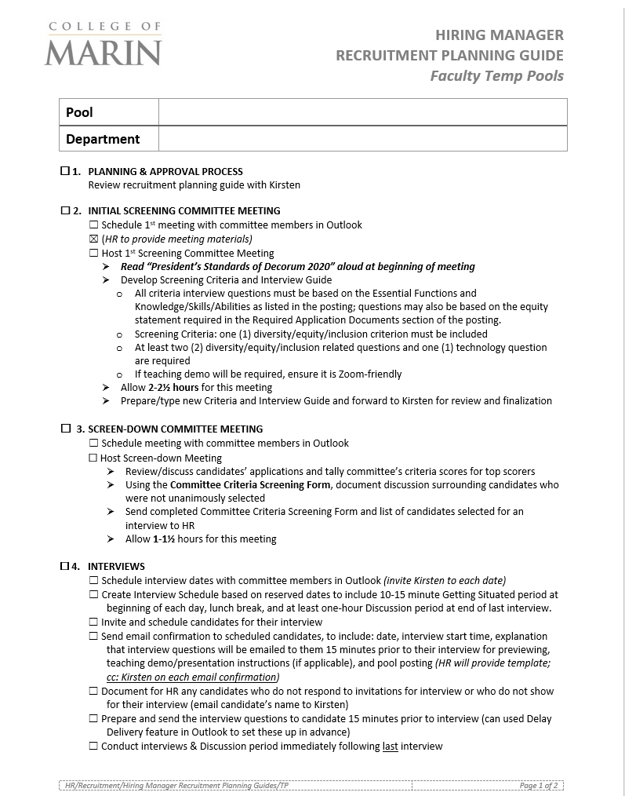
COMMITTEE PROCESS BEGINS (Continued)
HR confirms committee appointments with Senates and Superintendent/President and forwards to HM
HR issues Confidentiality Agreement to committee members
HR provides materials for 1st Committee Meeting to HM
Hiring Manager Recruitment Planning Guide (sample shown)
Copy of Recruitment Timeline
Copy of job/pool posting
Previously used screening criteria and interview guides (questions + guideline answers)
HM prepares committee packets to include the materials listed above (or sends electronically if meeting will be held remotely)
Notes:
HR will issue Confidentiality Agreements to all of the committee members and any supporting participants.
When all committee members have returned their signed Confidentiality Agreements and completed the training, the Hiring Manager may prepare to hold the first committee meeting.
HR will provide a Recruitment Planning Guide to the hiring manager that outlines the manager’s roles and responsibilities for that recruitment.
Next, HR will send the hiring manager the materials and tools for conducting the first committee meeting, including any previously used samples or templates that may apply.
For recruitments where the meetings will be held on campus, the Hiring Manager is responsible for preparing a packet for each committee member with copies of the relevant materials. For recruitments taking place remotely, materials should be sent electronically to the committee.

Slide 21
SCHEDULE 1ST COMMITTEE MEETING
HM schedules 1st meeting in Outlook and books room (if on-campus) or schedules Zoom meeting (if remote)
Typical 1st Meeting Durations
Classified: 2 – 2½ hours
Management: 2½ – 3 hours
FT Faculty: 2 – 2½ hours
Faculty Temp Pool: 1½ – 2 hours
Absentees
Encourage committee member to submit interview question suggestions prior to meeting
Provide summary to absentee following meeting
Absence at 1st meeting is acceptable, but interviews require 100% attendance
Notes:
1. The first committee meeting must be held before applications may be released to the committee for consideration.
2. When booking the first meeting, invite your Employment Services representative so that the meeting registers on their calendar.
3. Regarding Absentees: It is acceptable for a committee member to miss the 1st meeting, or the screen-down meeting later, but they MUST be available to attend ALL of the interviews in order to participate; otherwise, they must recuse themselves. If a committee member must step down, time permitting, a replacement should be requested from the respective senate, so please notify HR immediately when this occurs.

Slide 22
SCHEDULE SCREEN-DOWN MEETING
Screen-down Meeting date contingent upon when applications are to be released to committee and # of applications to review
HM schedules meeting in Outlook and books room & media equipment (if on –campus) or schedules Zoom meeting (if remote)
Typical Screening Periods Required
0 – 25 Apps: 1 week
25 – 50 Apps: 2 weeks
50 – 100 Apps: 2-3 weeks
100+ Apps: 3+ weeks
Notes:
1. The Recruitment Timeline should provide an estimated time period during which the screen-down meeting should be scheduled. Generally, it would take place anywhere from 1 to 3 weeks after the applications are released to the committee, depending on the number of applications to review.
2. Again, please invite the respective HR representative to the meeting so it registers on our calendar.
3. Media equipment may need to be requested from Media Services for meetings held on campus in rooms that are not already equipped with a computer/monitor so that the committee may refer to applicants’ materials during the meeting.
4. The Typical Screening Periods noted here are based on previous experience. Exempt employees, such as managers, supervisors, and faculty, may screen whenever they are able. But non-exempt employees must be provided sufficient time to complete the screening during normal business hours.

Slide 23
SCHEDULE SCREEN-DOWN MEETING (Continued)
Typical Screen-down Meeting Durations
Classified: 1 – 1½ hours
Management: 1 – 1½ hours
FT Faculty: 1 – 1½ hours
Faculty Temp Pool: 1 – 1½ hours
Committee member to send completed Criteria Worksheet to HM prior to meeting – HM serves as proxy
Post-meeting summary for absent committee member
Absence at meeting is acceptable, but interviews require 100% attendance
Notes:
1. Most screen-down meetings take between an hour and an hour-and-a-half.
2. If a committee member is not able to attend the screen-down meeting, the hiring manager may serve as their proxy, as long as the absentee sends their completed criteria worksheets to the hiring manager prior to the meeting. The absentee must have completed screening all of the applications in order for their results to be considered.

Slide 24
HM HOSTS 1ST COMMITTEE MEETING
President's Standards of Decorum
Elect Notetaker & Identify Co-facilitator
Determine Interview Format
Develop Screening Tools
HR Approval
Notes:
It’s meeting time!
Pause

Slide 25
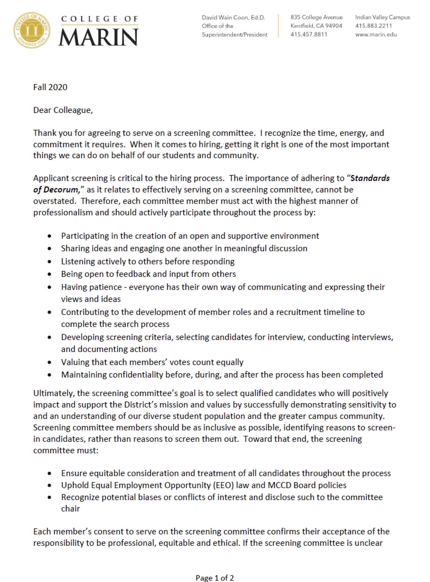
PRESIDENT'S STANDARDS OF DECORUM
HM must read the President's Standards of Decorum aloud at the beginning of the first committee meeting.
HM should ensure that all committee members acknowledge their acceptance of the responsibilities outlined in the Standards.
Notes:
At the beginning of the first committee meeting, it is very important that the Hiring Manager read the “President’s Standards of Decorum” aloud to the committee. These standards emphasize the committee’s responsibility to remain professional, equitable, and ethical throughout the course of the recruitment.

Slide 26
NOTETAKER & CO-FACILITATOR DETERMINE INTERVIEW FORMAT
ELECT NOTETAKER & IDENTIFY FACULTY CO-FACILITATOR
Document, document, document!
Faculty and Educational Administrative Positions: Per AP 7120 and to ensure all screening committee members' voices and opinions are heard during the deliberation process, a faculty member serving on the committee may volunteer to co-facilitate meetings and interviews with the hiring manager.
DETERMINE INTERVIEW FORMAT
STRUCTURE (1 or 2 Interviews)
CLASSIFIED: At the discretion of the HM, pending first interview’s outcome; however, typically, one interview is sufficient for most classified positions.
MANAGEMENT: President & Designee conduct final interviews; process may include a presentation for the campus community and meeting(s) with constituent groups.
FT FACULTY: President & Designee conduct final interviews; process includes a final teaching demo for Students and Screening Committee.
FACULTY TEMP POOLS: Committee Interview only; no 2nd/final interviews for pools.
LOCATION: Remote or Campus
PRE-INTERVIEW EXCERCISE, TEACHING DEMO, PRESENTATION
Notes:
We cannot stress enough the importance of documenting the committee’s actions and decisions throughout the recruitment process. And, HR will provide the tools to do so in some cases. But, to allow the hiring manager or co-facilitator to better facilitate the discussions, we encourage the committee to elect a notetaker to record new screening criteria, interview questions & guideline answers, and any other interview tools developed, as well as any discussions or deliberations held throughout the recruitment.
If a faculty member volunteers to serve as co-facilitator, please make a record of this in your notes for HR.
Whether an interview’s structure will include one or two interviews depends on the type of position or if it’s a temp pool.
Under COVID-19 restrictions, all interviews are to be held remotely. Under normal operations, the committee may elect to offer a remote interview to its candidates or to conduct the interview in person.
The committee may elect to require the candidate to perform a skills exercise immediately prior to their interview, the results of which would be considered during the deliberation period. Similarly, the candidate may be expected to conduct a teaching demo or presentation during their interview to demonstrate their knowledge, skills and abilities. These decisions must be made during the first meeting, prior to the committee’s viewing any of the applications.

Slide 27
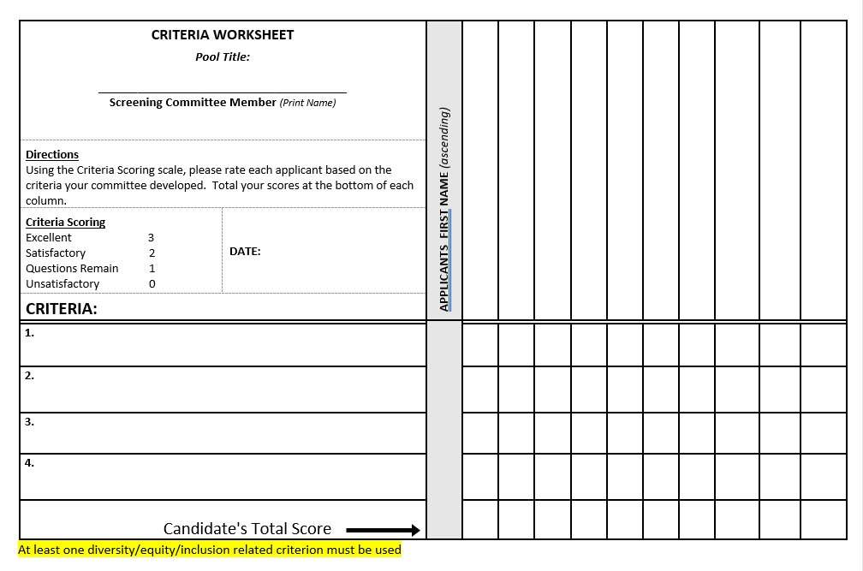
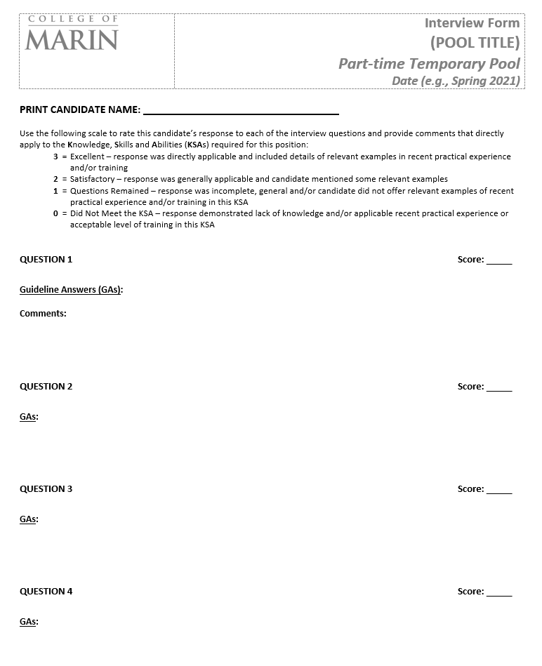
DEVELOP SCREENING TOOLS & HR APPROVAL
DEVELOP SCREENING TOOLS
Committee Develops:
Screening Criteria Worksheet (sample shown)
Interview Guide (sample shown)
Questions & Guideline Answers
Pre-interview Exercise, Teaching Demo or Presentation Topic & Instructions (if applicable)
HM types and submits new criteria, interview guide, and exercise/demo/presentation instructions to HR for review
HR APPROVAL
HR reviews screening tools for adverse impact and compliance. Areas for concern will be addressed with HM prior to approval.
Notes:
Screening criteria should be based on the Essential Functions, Knowledge, Skills & Abilities, and/or the Desirable Qualifications as listed in the posting. Criteria may also be based on whatever supplemental documentation the applicant was required to attach to their application, such as an equity statement. At least one criterion must be diversity, equity or inclusion based.
As for interview questions, at least two questions related to diversity, equity or inclusion must be asked, and at least one technology-based question must be asked.
All interview questions, exercises, teaching demos and presentations must be accompanied by a guideline answer
Following the meeting, and as soon as possible, please email the newly developed criteria, interview guide, and any other screening tools to HR for review. HR cannot release applications to the screening committee for consideration until we have received and approved these materials.
Please remember that the development of these screening tools is considered a highly confidential process. The committee should be reminded not to share any of the materials outside the committee’s meetings. Except for the Notetaker, any notes taken by committee members throughout the development process should be shredded or destroyed. For in-person meetings, the hiring manager should collect the committee’s notes at the end of the process to ensure they are destroyed appropriately.

Slide 28
APPLICATION SCREENING & SCREEN-DOWN MEETING
Notes:
It’s time to screen applications and hold the screen-down meeting!

Slide 29
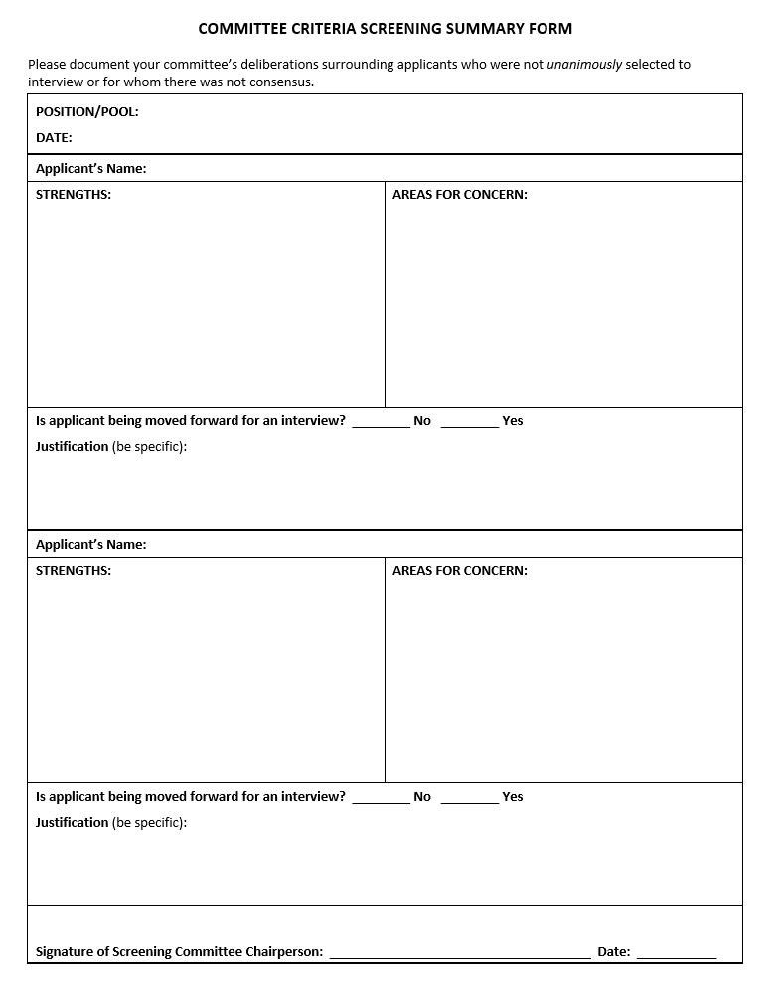
APPLICATION SCREENING & SCREEN-DOWN MEETING
APPLICATION SCREENING
HR provides access to applications in NeoEd to Screening Committee
Committee screens applications against criteria developed in 1st meeting using Screening Criteria Worksheet
SCREEN-DOWN MEETING
HM hosts screen-down meeting to discuss/deliberate committee’s criteria screening results
Elect Notetaker: document, document, document!
Use Committee Criteria Screening Summary form to record discussion surrounding candidates who were not unanimously selected to interview (sample shown)
HM confirms that internal candidates entitled to interview per collective bargaining agreements are included in list of selected candidates
HM reports consensus results to HR immediately following meeting
Notes:
With the newly developed screening criteria and interview guide in hand from the hiring manager, HR will release the applications to the committee for consideration.
HR will provide the Committee Criteria Screening Summary form to the Hiring Manager, which will assist in documenting candidates where there may not have been consensus.
Even though an internal applicant may be contractually entitled to an interview, it is important to allow the applicant to move through the selection process organically. The committee should rate them as any other applicant so that there is a documented record of their actual standing.

Slide 30
HM SCHEDULES INTERVIEW DATES
Committee Interview
2nd/Final Interview
Notes:
Once the application screening is underway, that is a good time to book interview dates!
Pause

Slide 31
COMMITTEE INTERVIEW - Scheduling
HM books interview dates on committee’s calendars
For on-campus interviews, HM appoints a greeter and reserves interview room and media equipment
HM invites candidates to interview and confirms the interviews, including any exercise, demo or presentation instruction
Typical Interview Durations
Classified: 45 – 60 minutes
Management: 75 – 90 minutes
FT Faculty: 60 – 75 minutes
Temp Pools: 45 – 60 minutes
*Committee member participation requires 100% attendance for interviews.
Notes:
For all recruitments, candidates are given at least 15 minutes to preview the interview questions prior to their interview. For remote interviews, the questions are emailed to the candidate in advance; for campus interviews, the candidate reports to the appointed greeter, who will provide the interview questions to the candidate for preview. The greeter should set aside a relatively quiet place with a writing surface so that candidates may take notes while previewing the questions. If a pre-interview exercise is expected, the equipment and materials should be reserved accordingly.
For campus interviews, conference rooms are best suited for classified and management positions, while for faculty positions and pools, SMART classrooms provide the best setting for allowing teaching demonstrations. Be sure to inventory the intended room’s media equipment to ensure that any demos or presentations will be feasible and that the committee and candidate will fit in the space.

Slide 32
2ND/FINAL INTERVIEW - Scheduling
Best to book 2nd/final interview date(s) after the committee interview date(s) is known
Typical 2nd/Final Interview Formats:
Classified: Final interview with HM & Designee. In rare instances, members of the screening committee may be asked to participate in the final interview.
Management: Final presentation/demo; Meet & Greet(s) with position’s constituents; and final interview with President & Designee.
FT Faculty: Final teaching demo for actual students & screening committee; and final interview with the President & Designee.
Temp Pools: None
Typical 2nd/Final Interview Durations
Classified: 45–60 minutes
Management: 3–4 hours, depending on number of events
FT Faculty: 30–45 minutes for demo + 30–60 minutes for final interview
Notes:
HR recommends waiting to book the final interview dates until after the committee interview date is known. This ensures that sufficient time is provided between interviews for the candidates, especially if the final interview will be in person and they must make travel or other arrangements to attend.
All Faculty and Management positions will require a 2nd, or final, interview. For classified positions, it should be determined during the discussion of the first interview and in consultation with HR, unless it was determined by the HM at the beginning of the recruitment that a 2nd interview should be required.

Slide 33
PREPARING FOR INTERVIEWS
Interview Invitations & Confirmations
Interview Materials
Notes:
Now that interview dates are set and interview candidates have been selected, invitations may go out and preparations may begin.
Pause

Slide 34
INVITATIONS, CONFIRMATIONS & INTERVIEW MATERIALS
INTERVIEW INVITATIONS & CONFIRMATIONS WITH CANDIDATES
HM invites candidates to interview, assigns them an interview time, and emails a confirmation to include all of the pertinent details (e.g., date, time, explanation of 15-minute question preview, teaching demo/presentation instructions, Zoom details, parking permit)
HM documents for HR any candidates who do not respond to invitations or who withdraw from consideration
HM sends HR the interview schedule after all interviews are confirmed
INTERVIEW MATERIALS
HR sends interview materials to HM
HM prepares interview folders for Screening Committee (campus only); for remote interviews, materials may be emailed
Notes:
HR will provide the hiring manager with email templates for inviting candidates to and for confirming their interviews, which the hiring manager may use, or they may create correspondence of their own. Either way, HR will advise as to what pertinent detail should be included in the emails.
Prior to the interview date, HR will email the interview materials to the hiring manager for preparing the screening committee’s interview packets. For remote interviews, either HR or the Hiring Manager may send the materials to the committee electronically.

Slide 35
INTERVIEWS
1st Interviews
2nd/Final Interviews
Notes:
The moment has come to meet your candidates!

Slide 36
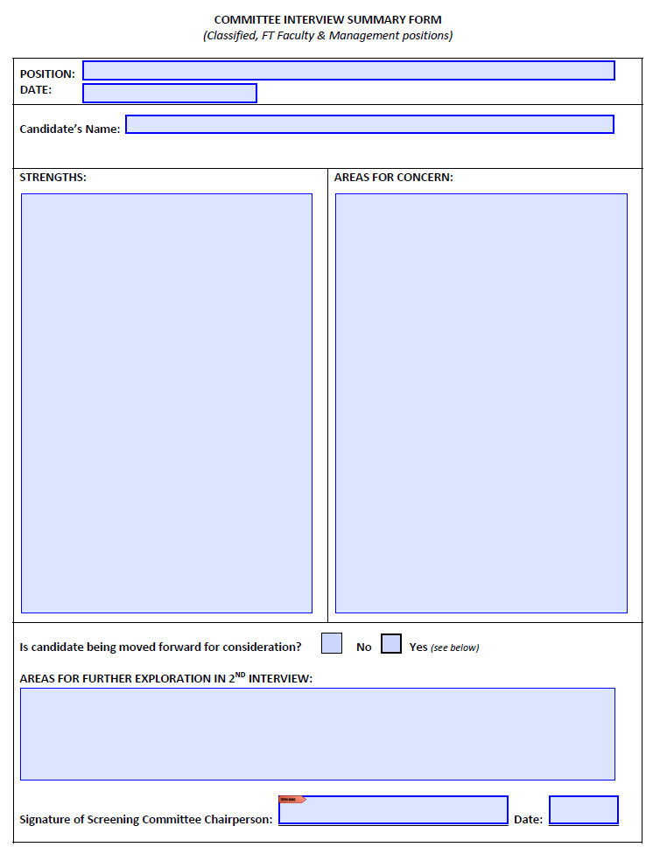
1ST INTERVIEWS
QUESTION PREVIEW & EXERCISE
Campus Interviews: Candidate reports to designated Greeter, who provides the interview questions and exercise (if applicable) to the candidate.
Remote Interviews: HM emails interview questions to candidate prior to the interview for previewing (usually 15 minutes). If an exercise is required, HM also emails candidate the exercise instructions and candidate performs exercise in combination with previewing the questions (typically 30-45 minutes total).
HM HOSTS INTERVIEW
Committee introductions
Review interview format with candidate (e.g., round robin, spokesperson)
Following last interview, HM and Faculty Co-facilitator (if applicable) facilitate the discussion/deliberations.
HM or Notetaker records the Strengths and Areas for Concern for each candidate and the Areas for Further Exploration for finalists to be moved forward using the Committee Interview Summary form (shown), to be provided by HR
HM submits completed Committee Interview Summary forms to HR
HM identifies last-minute candidate withdrawals or “no-shows” for HR
HR notifies candidates not selected to move forward as finalists
NEXT STEP: Either 2nd/Final Interviews or Reference Checks…
Notes:
For campus interviews where a Greeter will be assisting the candidate with the question preview, it’s important that the candidate be situated in a relatively quiet space with a writing surface, paper, and a pen, so that they may take notes.
At the end of the candidate’s designated question preview period, for campus interviews a member of the screening committee should collect the candidate from the Greeter and escort them to the interview room. For remote interviews, the Zoom settings should require the candidate to wait in the waiting room until the hiring manager has admitted them to the meeting.
After making introductions, the hiring manager should describe for the candidate how the questions will be asked, whether in a round-robin or through a spokesperson. The same format should be applied to every candidate, and if employing the round-robin method, the same committee member should ask the same question or questions of every candidate to ensure consistency.
As a courtesy, HR recommends informing the candidate that the committee members will be taking notes throughout the interview, whether by hand or on their computers.

Slide 37
2ND/FINAL INTERVIEWS
INTERVIEW INVITATIONS & CONFIRMATIONS WITH CANDIDATES
Once authorized by HR, HM schedules finalists’ 2nd interviews and emails a confirmation to include all of the pertinent details (e.g., date, time, final teaching demo/presentation instructions, Zoom details, daily agenda, parking permit)
No question preview period prior to 2nd/Final Interviews
HM sends the final interview schedule to HR, interviewers, and other pertinent participants after all interviews are confirmed
PARTICIPANT COORDINATION
HM coordinates and confirms 2nd/Final Interview participants. For example:
Students (for final teaching demos)
President & Designee or Final Interview Team
Screening Committee (if they are expected to participate in a final demo/presentation)
Student Ambassadors (if campus tour is planned)
Meet & Greet and/or Campus Forum Participants (for presentations)
Notes:
Final interviews may not be scheduled without the prior consent of HR.
Depending on the position, the President’s or Designee’s office may coordinate the final interview events, participants, invitations and confirmations.
When scheduling final interviews, finalists should be instructed to arrive at their designated interview start time - final interview questions are not provided to the candidates ahead of time. They’re on their own for this one!
Once the interview schedule, including all events, is set, the hiring manager should distribute it to all of the participants involved, unless the President or Designee’s office is coordinating.
For final interviews with a teaching demo, presentation, Meet & Greet, and/or campus tour, the hiring manager will be responsible for recruiting the participants to these events and working with the President’s or Designee’s office to coordinate the scheduling accordingly.

Slide 38
2ND/FINAL INTERVIEWS (Continued)
HM HOSTS 2ND/FINAL INTERVIEW & DEMO/PRESENTATION
Classified Positions:
HM &/or Designee(s) host the actual interview
FT Faculty and Management Positions:
President & Designee host the actual interview
HM ushers finalists through the day’s various events
HM hosts final teaching demos/presentations
HM hosts Screening Committee’s discussion/deliberation following final teaching demos
With the Committee, HM presents Committee’s feedback from discussion to President & Designee (faculty positions only)
Notes:
For classified positions, the hiring manager and/or a designee will conduct the final interview. For full-time faculty and management positions, the President & Designee will host the final interview, but the hiring manager will normally be expected to host the final demo or presentation and any subsequent deliberations by the screening committee.
Pause

Slide 39
REFERENCE CHECKS
Notes:
Following the final interviews, either the hiring manager, or the President or Designee, notifies HR of which finalist has been selected for reference checking.

Slide 40
REFERENCE CHECKS
CLASSIFIED POSITION – Reference Checks
References to be conducted by HM following final interviews or committee interviews (where a final interview does not apply) with HR’s authorization.
FT FACULTY & MANAGEMENT POSITIONS – Reference Checks
References conducted by HM upon request by the President or Designee and with HR’s authorization
REFERENCE CHECK PROCESS
Candidate must be contacted for approval to check references prior to contacting any reference
HR to provide HM with Reference Check Form/template – Document! Document! Document!
At least one reference question must focus on diversity/equity/inclusion
Obtain at least 3-4 references, preferably including a combination of the finalist’s listed references and current/former supervisors
HM submits the completed Reference Check forms to HR (classified positions)
HM summarizes in writing the reference check findings from each reference for the President or Designee and provides the completed Reference Check forms or HM’s complete reference notes, including all questions asked and responses given, to HR (faculty and management positions)
HM emails all reference notes to HR for recruitment file
Notes:
Reference checks should not begin without the prior authorization of HR.
Whether using the Reference Check Form or creating a template of your own, please document each conversation or exchange carefully, including the questions asked and responses given, and ensure that questions are consistent from one reference to another.
It is critical that the all of the completed reference check forms and notes be emailed to HR for the recruitment file.
No reference checks are conducted for temp pool appointees.

Slide 41
FILLING A POSITION/POOL
Salary Placement
Job Offers & Regrets
Temp Pool Appointments
Notes:
Upon receiving favorable reference checks, a conditional job offer may be made.

Slide 42
SALARY PLACEMENT
Salary Schedules may be found on the Classification & Compensation page of the HR web site.
Classified
HM should consult with HR regarding salary step & eligible hire date
Management
Superintendent/President determines placement within prescribed Management Salary Schedule range
FT Faculty
Based on verified educational background and experience and is non-negotiable
PT Faculty
Based on verified educational background and experience, is non-negotiable, and is paid at 95% of the designated, published salary
Notes:
Salary placement on the position’s respective salary schedule is determined based on background and experience, and in most cases is not negotiable.
PAUSE

Slide 43
JOB OFFERS & REGRETS
CLASSIFIED
HM or appropriate manager makes conditional, verbal offer to selected finalist and communicates to HR if the offer is accepted or not.
If only one interview is held, HR notifies other interviewed candidates of their status.
If two interviews are held, HM notifies finalists who were not selected for the position and confirms with HR when this is completed; if notification is made via email, HM forwards copy of email to HR for record.
MANAGEMENT
President makes conditional, verbal offer to selected finalist and communicates to HR if the offer is accepted or not.
President’s designee notifies finalists who were not selected for the position and confirms with HR when this is completed; if notification is made via email, Designee forwards a copy of email to HR for record.
FT FACULTY
President makes conditional, verbal offer to selected finalist and communicates to HR if the offer is accepted or not.
President’s designee or HM notifies finalists who were not selected for the position and confirms with HR when this is completed; if notification is made via email, Designee forwards a copy of email to HR for record.
ALL POSITION TYPES
HR follows up with conditional, written offer and Employment Agreement (management positions only) to selected finalist.
Upon receipt of signed written offer, HR prepares the position’s appointment for next eligible Board agenda.
HR initiates onboarding process with new employee; onboarding may proceed while awaiting for Board approval.
Notes:
All job offers are considered conditional, pending the finalist’s successful completion of all District-required clearances.
For full-time faculty and management positions, the Superintendent/President will make the offer. And, for classified positions, in most cases, the hiring manager will offer the position to the finalist.
As soon as a verbal offer is accepted, it’s important to relay that information to HR immedidately so that the written offer and management employment agreements may be drawn up and issued quickly.
HR cannot submit an appointment to the Board of Trustees for approval until the written offer is return to HR. So, time is often of the essence, as the new employee may not begin working until Board approval is received.
Upon receipt of the signed, written offer, HR will initiate the onboarding process with the new employee, and onboarding may take place while awaiting the Board’s approval.

Slide 44
TEMP POOL APPOINTMENTS
Following the Screening Committee’s discussion/deliberations, HM sends list of appointed candidates to HR.
HR notifies all temp pool candidates of their status.
HM or Department Chair notifies HR when a pool appointee is offered and accepts first assignment in order for HR to initiate onboarding.
Notes:
With temp pools, the newly appointed instructors are notified by HR that they have been added to the pool, but there is no formal offer of employment since temp pool assignments are not guaranteed.
Once the department calls upon a new pool member to assign units, the hiring manager or department chair must notify HR so that we may initiate onboarding at that time.

Slide 45
FINAL STEPS & CONSIDERATIONS
Return Recruitment Materials to HR
Failed Recruitments
Recruitment Durations
Administrative Support
Resources
Notes:
At this point, hopefully the position or pool has been filled successfully! Following are final steps and points to consider.

Slide 46
RETURN RECRUITMENT MATERIALS TO HR & FAILED RECRUITMENTS
RETURN RECRUITMENT MATERIALS TO HR
All recruitment materials must be sent electronically to HR at end of process, including:
Copies of emailed interview confirmations to candidates
Interview Schedules
Committee’s completed criteria screening forms
Committee’s completed interview guides
Committee’s final demo/presentation notes
Committee rating forms, survey results, student feedback forms (faculty & management positions)
Committee Criteria Screening Summary and Committee Interview Summary forms
Candidates’ teaching demo or presentation handouts/materials*
Reference check notes
Any other materials completed and collected during the course of the recruitment
*If these are not in electronic format, okay to send via interoffice mail.
FAILED RECRUITMENTS
If a position or pool is not filled successfully, HM should consult HR to determine next steps.
Notes:
At the end of each recruitment, all of the materials developed and collected during the course of the recruitment should be sent electronically to HR for the master recruitment file. If some items have already been sent, there is no need to re-send them; otherwise, please return everything to HR as soon as possible. Once materials have been received electronically by HR, any original, hard copies of the materials should be shredded or sent to HR via interoffice mail, and HR will shred them.
When a position or temp pool is not filled successfully, there may be more than one option moving forward, so please consult HR to determine what is most advisable at the time.

Slide 47
RECRUITMENT DURATIONS & ADMINISTRATIVE SUPPORT
RECRUITMENT DURATIONS
Typical Durations:
Classified: Approx. 2½ - 3 months
Management: Approx. 3½ - 4 months
FT Faculty: Approx. 3½ - 4 months
PT Faculty: Approx. 2 – 3 months
ADMINISTRATIVE SUPPORT
HM may delegate certain recruitment steps and tasks to an administrative support champion to support their recruitment, including but not limited to:
Typing up newly developed criteria and interview guides
Preparing committee packets and/or distributing materials to committee members
Booking meetings/interviews/media
Scheduling and confirming candidates’ interviews
Greeting candidates for pre-interview exercises and question previews
Collecting and returning recruitment materials to HR at end of recruitment
Notes:
A recruitment’s duration hinges on three main variables: 1.) How quickly a committee may be formed; 2.) The screening committee’s availability and level of flexibility; and 3.) For FT Faculty and Management positions, the President & Designee’s co-availability and flexibility. Because most recruitments take at least a couple of months to complete, HR does not recommend that any Hiring Manager hold more than three recruitments in any given semester.
The Hiring Manager may designate a staff member to assist them with the recruitment’s administrative tasks. As a participant to the recruitment, this support champion would also be expected to sign the Confidentiality Agreement.

Slide 48
RESOURCES
Minimum Qualifications for Faculty & Administrators in California Community Colleges
MCCD BP 7120 & AP 7120 – Employment Recruitment
MCCD BP 7210 & AP 7210 – Academic Employees
MCCD AP 7211 – Faculty Service Areas, Minimum Qualifications, and Equivalencies
MCCD AP7212 – Temporary Faculty
MCCD Collective Bargaining Agreements
MCCD Classification & Compensation
COM HR Department’s Guidelines for Recruitment & Hiring
COM HR Department’s Career Opportunities (for applicants)
COM HR Department’s Employment FAQs (for applicants)
Notes:
We encourage you to review these important resources and to save them for future reference.

Slide 49
EMPLOYMENT SERVICES TEAM
Classification & Compensation
NIKKI HARRIS, Executive Director of Human Resources
nharris@marin.edu
(415) 485-9520
Classified & Classified Management Positions
JULIE BREAKSTONE, Employment Services Coordinator
jbreakstone@marin.edu
(415) 485-9331
Faculty Positions/Pools & Educational Administrative Positions
KIRSTEN GISLE, Employment Services Coordinator
kgisle@marin.edu
(415) 485-9342
Notes:
Please feel free to reach out to any of us if you have any questions or need clarification regarding the recruitment process. We are looking forward to working with you to fill your openings!

