Slide 1
Medicare 101
Presented by:
Frank Impastato, Account Manager
May 6, 2025

Slide 2
Welcome to Kaiser Permanente - 2025
Presenting Medicare 101 and the Kaiser Permanente Medicare health plans
Presented by
Diego Realpe, Kaiser Retiree Solutions Manager

Slide 3
Understanding the basics of Medicare
MEDICARE FOR group MEMBERS
3

Slide 4
Who can join Medicare?
MEDICARE FOR group MEMBERS
You’re eligible to join Medicare if:
You’re 65 or older
You’re under 65, but live with a disability
Must be eligible for Social Security disability
Requires a 2-year waiting period
You have end-stage renal (kidney) disease (ESRD)
You have amyotrophic lateral sclerosis (ALS)
U.S. citizen or a permanent legal resident who has lived in the United States for at least five years

Slide 5
What is Medicare?
MEDICARE FOR GROUP MEMBERS
Medicare is a federally funded health insurance program.
Medicare was established in 1965.
Medicare is administered by the Centers for Medicare & Medicaid Services (CMS).
Medicare includes 4 parts:
PART A
Hospital Insurance
PART B
Medical Insurance
PART D
Prescription
Drug Coverage
PART C
(Medicare Advantage)
Includes Part A, B
and usually D
Original Medicare

Slide 6
MEDICARE FOR GROUP MEMBERS
Part A: Hospital Insurance
What it does:
Gives you coverage for inpatient hospital care
Also covers skilled nursing care, hospice care, and home health care
What it costs:
Most won’t have to pay a premium for Part A. To make sure you qualify for premium-free Part A, contact Social Security.
If you worked less than 10 years, there is a monthly premium up to $518*, your monthly premium is set by a Medicare formula.
* Amount is for 2025

Slide 7
Part B: Medical Insurance
MEDICARE FOR GROUP MEMBERS
What it does:
Helps cover doctors’ and other health care providers’ services, like lab and radiology
Outpatient care, durable medical equipment, dialysis, and some preventive care services are also covered
What it costs:
Your monthly premium is usually deducted from your Social Security or Railroad Retirement Board check.
Late enrollment penalty (LEP):
Your premium increases 10% for each 12-month period that you decline coverage.
Not a one-time penalty but continues throughout enrollment.
Not imposed if you continue to work for — and get your health coverage from — an employer or trust fund of 20 or more. (You have up to 8 months after your employment ends to enroll.)

Slide 8
Part B: Medical Insurance
MEDICARE FOR GROUP MEMBERS
2025 Medicare Part B Monthly Premiums*
Your yearly income† |  | You pay
Single-Standard‡ Married couple-standard‡ | $106,000 or less $212,000 or less | $185.00‡
Single Married couple | $106,001 - $133,000 $212,001 - $266,000 | $259.00
Single Married couple | $133,001 - $167,000 $266,001 - $334,000 | $370.00
Single Married couple | $167,001 - $200,000 $334,001 - $400,000 | $480.90
Single Married couple | $200,001 - $500,000 $400,001 - $750,000 | $591.90
Single Married couple | Above $500,000 Above $750,000 | $628.90
Your yearly income† | You pay
If you’re married but file a tax return separately from your spouse
$106,000 – or less Standard‡ | $185.00‡
$106,000 – less than $394,000 | $591.90
Greater than or equal to $394,000 | $628.90
†Modified adjusted gross income as reported on your 2023 IRS tax return.
‡You will pay this Standard amount if you 1) enroll in Part B for the first time in 2025, 2) do not get Social Security benefits, 3) are directly billed for your Part B premiums. See medicare.gov for complete details.
*Note: The above dollar amounts are for 2025 and may change in 2026.
Notes:
This chart illustrates and breaks down how CMS sets premiums for Part B. Premiums are assessed based on your household income.
Medicare takes a 2 year look back at your retirement income to determine your Part B premium. What this means is that when you are deciding to retire, they will be looking at your income from two years prior. So, if you retire in 2025, they will be looking at your income from 2023.
For example, a single individual earning $106K or less, or a married couple earning $212K or less will be paying the 2025 standard premium of $185.00
You can see that the higher the income bracket, the higher the premium amount is.
Some of you may be wondering “what if my income is a lot less this year”, if that’s the case, we encourage you to contact Social Security to see if they can do a review or audit to determine your Part B premium based on your true retirement income.
If you are married and filing separately, be sure to note the increased Part B premium. For any questions this higher assessment, be sure to contact Social Security and your tax advisor.

Slide 9
Part A & B: Enrolling in Medicare When First Eligible
MEDICARE FOR GROUP MEMBERS
Initial Enrollment Period
If you’re already getting benefits from Social Security, you’ll be automatically enrolled in both Part A and Part B starting the first day of the month you turn 65.
If you do not get benefits from Social Security, you’ll need to contact Social Security.
You can enroll over a 7-month period, which starts 3 months before your 65th birthday, known as the Initial Enrollment Period.
You may be able to enroll online at socialsecurity.gov.
3 months before your 65th birthday
The month of your 65th birthday
3 months after your 65th birthday
Note: Completing the application form and submitting it doesn’t automatically enroll you in Medicare Part B. Social Security must first determine if you’re eligible.

Slide 10
Part A & B: Late Enrollment Into Medicare
MEDICARE FOR GROUP MEMBERS
General Enrollment Period
If you do not sign up for Part A and Part B when you’re first eligible, you can sign up between January 1 and March 31 each year. When you sign up during this period, your coverage starts the first day of the month after you sign up.
Coverage begins the first day of the month AFTER you sign up
JAN
FEB
MAR
APR
January 1 – March 31
GEP
Notes:
If you miss the initial enrollment period, you can sign up during the General Enrollment Period.
The General Enrollment Period is January 1st and March 31st each year. You will sign up for Medicare during this time and your coverage will start the first day of the month after you sign up

Slide 11
Part A & B: Working Past Age 65? Enroll Into Medicare When You Retire
MEDICARE FOR GROUP MEMBERS
Special Enrollment Period
If you continue to work past your 65th birthday, you have 8 months to enroll in Parts A and B after you retire.
OR
While you have coverage from an employer
The 8 months after your coverage ends for Parts A & B
Notes:
You can also enroll if you have Special Enrollment period, which is triggered by certain events, such as loss of employment or retirement, that allow you to change plans.

Slide 12
Part D: Prescription Drug Coverage
MEDICARE FOR GROUP MEMBERS
What it does:
Covers outpatient prescription drugs
To enroll:
You have two ways of enrolling in Part D:
Through an individual or employer/union Group Medicare Advantage (Part C) plan that includes Part D prescription drug coverage.
A stand-alone Prescription Drug Plan that offers prescription drug coverage only.
Unlike with Parts A and B, you sign up for Part D directly with your plan. Part D is not directly offered by Medicare or Social Security.

Slide 13
Part D: Prescription Drug Coverage
MEDICARE FOR GROUP MEMBERS
Medicare Part D Income Related Monthly Adjustment Amount (IRMAA)
The Part D higher-income premium is in addition to the annual Part B premium adjustment and is determined according to formulas set by federal law.
Based on your 2023 yearly income, your 2025 Part D monthly cost is:
File individual tax return | File joint tax return | In 2025, you pay monthly
$106,000 or less | $212,000 or less | No Part D IRMAA Premium
$106,001 to $133,000 | $212,000 to $266,000 | $13.70
$133,001 to $167,000 | $266,001 to $334,000 | $35.30
$167,001 to $200,000 | $334,001 to $400,000 | $57.00
$200,001 to $500,000 | $400,001 to $750,000 | $78.60
above $500,000 | above $750,000 | $85.80
These amounts may change yearly.
Notes:
Medicare Part D has an income related monthly adjustment amount (IRMAA) for high earners.
This means if you are a higher income earner Medicare assesses additional premium for your Medicare Part D benefit.
For example, for a single individual earning $106k or less or a married couple making $212K or less, there is no additional premium amount adjusted. But if your income is greater than that, you can see the IRMAA is applied based on your income bracket.
You pay your Part D directly to your provider, AND then the IRMAA is paid directly to Social Security.
If you are assessed for the IRMAA adjustment, it is very important that you pay the amount to Social Security otherwise your risk the chance of getting disenrolled from your Part D plan.

Slide 14
Part C: Medicare Coverage Options
MEDICARE FOR GROUP MEMBERS
Here are some ways you can get Medicare coverage:
You get an Original Medicare Plan through the Centers for Medicare & Medicaid Services (CMS).
You can supplement Original Medicare by enrolling in a MediGap Plan. Premiums for these plans are not covered. (Note: Kaiser Permanente does not offer MediGap plans.)
You can sign up for a Medicare Advantage Plan, known as Medicare Part C, through private insurance companies.

Slide 15
Part C: Medicare Advantage
MEDICARE FOR GROUP MEMBERS
What it does:
Combines your benefits from Parts A, B, and sometimes D (prescription drug coverage) in a single plan and are an alternative to Original Medicare*
Services under a network of providers that you must use for care
What it costs:
Medicare pays an amount for your coverage each month to private health plans.
Some plans have additional monthly premiums; in many plans, you pay a copay for covered services.
If you choose an out-of-network provider, you’ll be financially responsible, except in the case of an emergency or urgent care.**
*Except care for some clinical research and hospice care (Original Medicare covers hospice care even if you’re in a Medicare Advantage Plan).
**Out-of-network/non-contracted providers are under no obligation to treat Plan members, except in emergency situations. Please call our customer service number or see your Evidence of Coverage for more information, including the cost-sharing that applies to out-of-network services.

Slide 16
Part C: Medicare Advantage
MEDICARE FOR GROUP MEMBERS
Types of Medicare Advantage plans:
Health maintenance organization (HMO) plans
Point-of-service (HMO-POS) plans
Preferred provider organization (PPO) plans
Private fee-for-service (PFFS) plans
Medical savings account (MSA) plans

Slide 17
Medicare’s Extra Help Program: Low-Income Subsidy
MEDICARE FOR GROUP MEMBERS
For Medicare beneficiaries with limited income and resources
Provides extra help with Part D premiums and outpatient drug copays
Degree of help depends on income and resources
Additional facts about extra help:
Apply at Social Security or state Medicaid office
Administered by your plan, for CMS
You must be enrolled in a Part D plan to get help

Slide 18
Get the confidence that comes with having a highly rated Medicare health plan
KAISER PERMANENTE MEDICARE HEALTH PLANS
Kaiser Permanente market Star rating*
California
Colorado
Georgia
Hawaii
Mid-Atlantic States (MD, VA, D.C.)
Northwest (OR, SW Washington)
Washington state
All Kaiser Permanente Medicare health plans earned either 4 or 4.5 stars out of 5 stars for 2025.
*Every year, Medicare evaluates plans based on a 5-star rating system.
18
Notes:
Each year the Centers for Medicare and Medicaid Services monitor and evaluate Medicare Health Plans. And rate the plans between 1 and 5 stars.
The ratings are based on:
Preventive Care
Chronic Care
Prescription Drug Services
Customer Service
And Member Satisfaction
And they give you an easy, unbiased way to evaluate the quality of different plans.
When comparing plans this rating system is helpful in giving you confidence, making it easy to choose a health plan.
For more information on the star ratings please visit kp.org/Medicarestars

Slide 19
Contact Information
MEDICARE FOR GROUP MEMBERS
If you have questions about the SISC Kaiser Permanente Medicare health plan, contact your Benefits Department.
Kaiser Permanente Member Services: 1-800-443-0815 (TTY 711)
7 days a week, 8 a.m. to 8 p.m.
Social Security: 1-800-772-1213 (TTY 1-800-325-0778)
Monday through Friday, 8 a.m. to 7 p.m.
Medicare: 1-800-MEDICARE (1-800-633-4227) (TTY 1-877-486-2048)
24 hours a day, 7 days a week.

Slide 20
Questions?
Kaiser Permanente is an HMO plan with a Medicare contract. Enrollment in Kaiser Permanente depends on contract renewal. You must reside in the Kaiser Permanente Medicare health plan service area in which you enroll.
20
Updated: October 2024

Slide 21
General Overview:
SISC Medicare Health
Plan Options
Marin Community College District
May 2025
Presented by:
Frank Impastato, Account Manager

Slide 22
Does SISC Offer Health Benefits for District Retirees?
Retirees under age 65 select from options that mirror the active employee plans available for districts corresponding bargaining units.
SISC offers member districts the choice of offering several Retiree Health Plan Options.
Each District will have different options, so you will need to check with your district benefit office in advance of retirement to see which options, if any, may be available to you.
SISC cannot answer questions regarding district contributions or eligibility for post-retirement benefits.
Districts may offer SISC’s direct billing program for eligible retirees who do not receive a district contribution.
22

Slide 23
Important Details for Retirees Age 65+
Regardless of plan option selected, it is very important to understand all of the following:
Retired members must enroll in Medicare Parts A & B on the first date of eligibility.
Members working past age 65 must enroll in Medicare Parts A & B on the first date following retirement.
Retired Medicare-eligible members must maintain continuous enrollment in Medicare Parts A & B or be subject to disenrollment and/or higher surcharged premiums.
Per CMS rules, members may only be enrolled in one Medicare Part D prescription drug plan.
All of the SISC Prescription Drug Plans are considered Creditable Coverage.
Retirees who do not enroll upon retirement will not be permitted to enroll in SISC Health Benefits at a future date.
Dependents may be added/dropped at the annual open enrollment.
23

Slide 24
What Options Are Available Through SISC Post-Retirement?
Companion Care Medicare Supplement Plan
Single $469 per member per month
Kaiser Permanente Senior Advantage (KPSA) Plan (HMO)
Single $351 per member per month
Blue Shield PPO for Retirees under age 65
Premium amounts vary by plan; verify what options are offered at your district
Blue Shield PPO Plans for Retirees over age 65
Premium amounts vary by plan; verify what options are offered at your district
All rates shown are effective 10/01/2025 – 09/30/2026.
24

Slide 25
What Options Are Available Through SISC Post-Retirement?
SISC PPO under age 65 (non-Medicare) with Prescription Drug Coverage
Network of Medical Providers is the Blue Shield PPO Network
Pharmacy Network excludes Walgreens
Members remain on the non-Medicare Prescription Drug Plan through Navitus
Plan options mirror those offered to the active employees of the applicable bargaining unit
Active & Fit discounted gym membership benefit is available
Retirees may remain on the under age 65 PPO plan provided:
One member is under age 65, and
All retired Medicare-eligible members enroll on the first date of eligibility and maintain continuous enrollment in Medicare Parts A & B
Otherwise, expensive Medicare surcharges will be applied
25

Slide 26
What Options Are Available Through SISC Post-Retirement?
SISC PPO 65+ with Medicare Prescription Drug Coverage
Network of Medical Providers is the Blue Shield PPO Network
There are two 100% Plan Options that vary by district; the prescription drug co-pay mirrors that of the active employee plan option(s).
Requires continuous enrollment in Medicare Parts A & B
Members who are disenrolled from a part of Medicare will be disenrolled and moved to a Non-Medicare retiree plan with a higher, surcharged premium.
Medical Claims:
Medicare is primary for covered medical claims; the plan pays secondary except in instances where Medicare denies a service but the plan provides a benefit. (Hearing aids and acupuncture, for example.)
Prescription Drug Benefits:
Members are enrolled in the Medicare Part D Prescription Drug Plan through Navitus. Medicare Part D prescription drug plan enhancements exclusively available to this plan include $0 generic copays, up to 90-day supply, at any participating pharmacy. (Not available on other plan options)
Active & Fit discounted gym membership benefit is available.
26

Slide 27
Overview of Plan Options - CompanionCare
CompanionCare is a Medicare Supplement Plan administered by Anthem Blue Cross with Medicare Part D prescription drug coverage provided through Navitus.
Requires continuous enrollment in Medicare Parts A & B.
Member self-refers to any U.S. provider who accepts Medicare assignment.
When the medical service is approved by Medicare, and the provider accepts Medicare assignment, the member cost share is zero.
Member co-pays for prescriptions: $9 generic, $35 brand. Costco zero copay program does NOT apply.
ASH Silver & Fit gym discount program available.
27

Slide 28
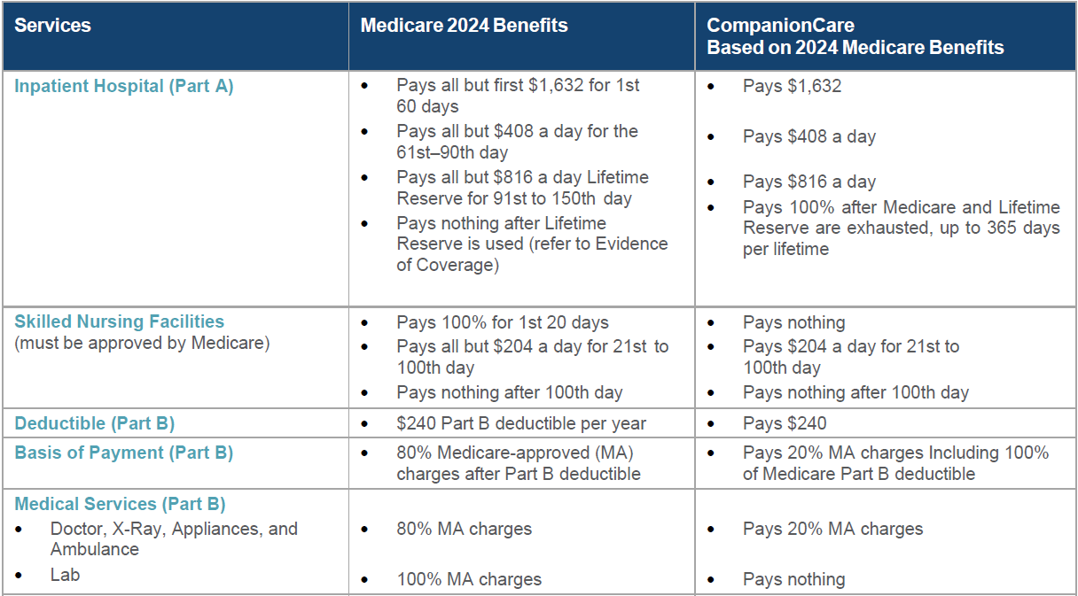
Summary of Benefits (10/01/24 – 09/30/25)
Anthem Blue Cross CompanionCare
Important note: this is a benefit overview of SISC’s CompanionCare group plan where all services must be approved by Medicare to be covered on this plan. All benefits are subject to the definitions, limitations, and exclusions set forth in the Anthem CompanionCare Plan Evidence of Coverage. No $0 generics at Costco on this plan.

Slide 29
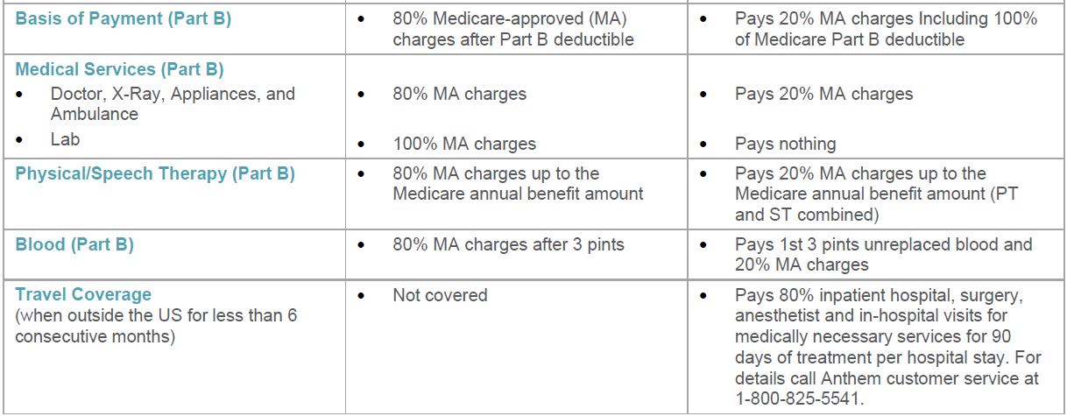
Summary of Benefits (10/01/24 – 09/30/25)
Anthem Blue Cross CompanionCare
Important note: this is a benefit overview of SISC’s CompanionCare group plan where all services must be approved by Medicare to be covered on this plan. All benefits are subject to the definitions, limitations, and exclusions set forth in the Anthem CompanionCare Plan Evidence of Coverage. No $0 generics at Costco on this plan.

Slide 30
Overview of Plan Options – Kaiser Permanente Senior Advantage
KPSA is a Medicare Advantage Plan (HMO) with a Medicare Part D prescription drug coverage.
Requires continuous enrollment in Medicare Parts A & B.
Family member/dependent under age 65 continues on KP HMO plan, not KPSA
Medicare must be assigned to Kaiser Permanente
Cannot use Medicare card with non-KP provider
SISC members must live in the KPSA service area within the state of California.
SISC KPSA members traveling are covered worldwide for any emergency and urgent care services.
SISC Kaiser Permanente Senior Advantage Plan members are enrolled in Medicare Part D prescription drug plan. Member co-pays for prescription: $10 generics, $20 brand for up to a 100-day supply.
Kaiser Medicare Members OnePass gym discount program available.
30

Slide 31
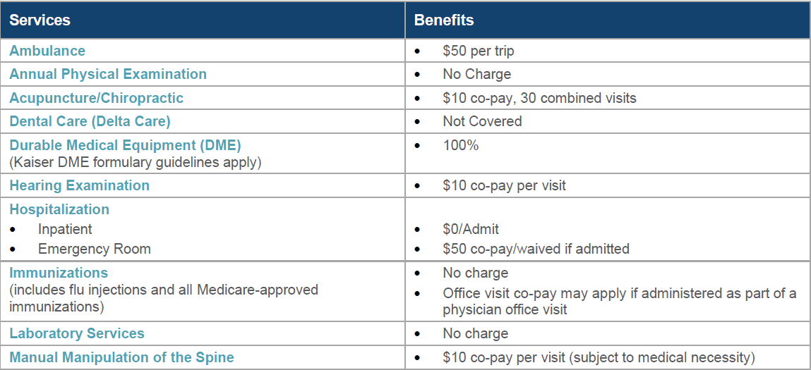
Summary of Benefits (10/01/24 – 09/30/25)
Kaiser Permanente Senior Advantage
Important note: this is a benefit overview of SISC’s Blue Shield 65 Plus Medicare Advantage group plan for in-network services.
All benefits are subject to the definitions, limitations, and exclusions set forth in the Blue Shield 65 Plus Evidence of Coverage.

Slide 32
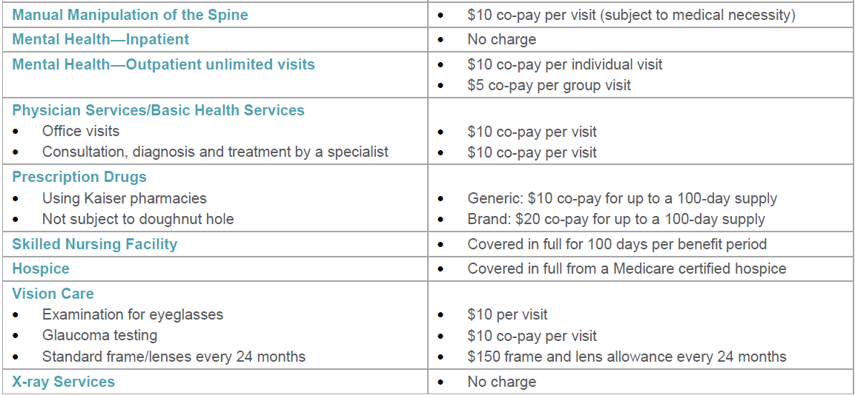
Summary of Benefits (10/01/24 – 09/30/25)
Kaiser Permanente Senior Advantage
Important note: this is a benefit overview of SISC’s Kaiser Permanente Senior Advantage group plan for in-network services.
All benefits are subject to the definitions, limitations, and exclusions set forth in the Kaiser Permanente Senior Advantage Plan Evidence of Coverage.

Slide 33
Thank you!
Questions?

